Slide 1
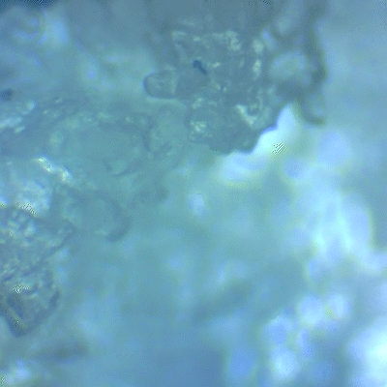
Sweat Matters
Turning sweat into innovation via human-centered design.

Slide 2
Context:
Sweat has been a constant challenge in my life due to my hyperhidrosis condition, something I’ve always tried to hide or control. Now, I want to shift my perspective and give it value, exploring its potential rather than avoiding it.
The more I research, the more I realize how unexplored and fascinating sweat is, with unique properties and untapped applications.
It’s deeply human, and through the lens of human sensing, I see it as a material for experimentation and innovation.

Slide 3
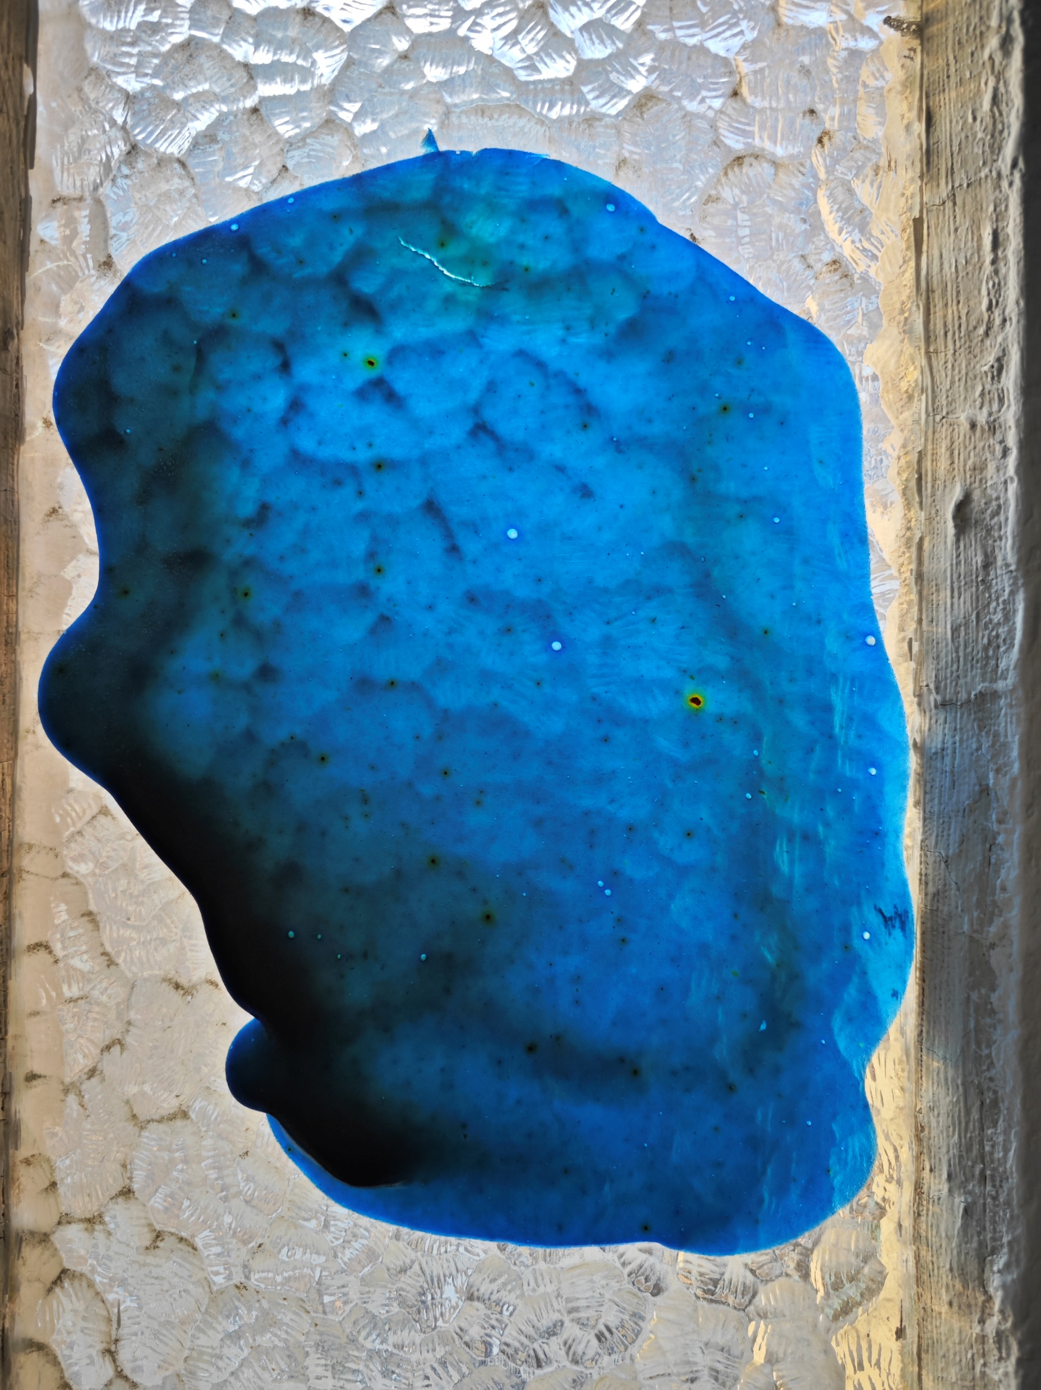
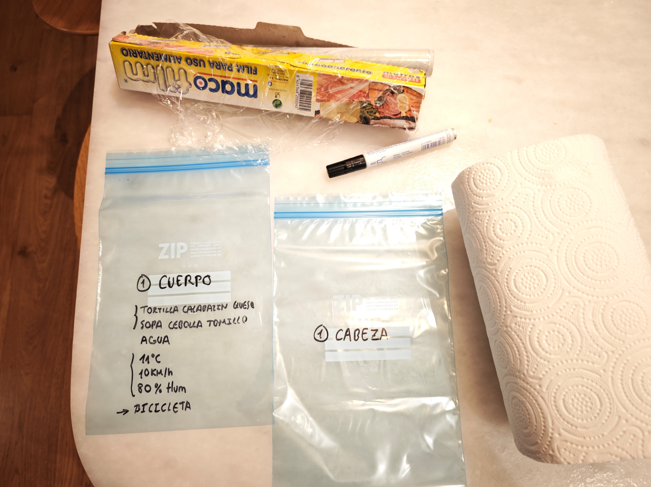
Project Purpose:
Why: Challenging the stigma around sweat and revealing its potential to foster acceptance and innovation.
How: Through hands-on experimentation with pH-sensitive materials, biomaterials, and conductivity to transform its perception.
What: Sweat-responsive wearables and experimental kits that merge practicality and creativity, redefining how we use and experience sweat.

Slide 4
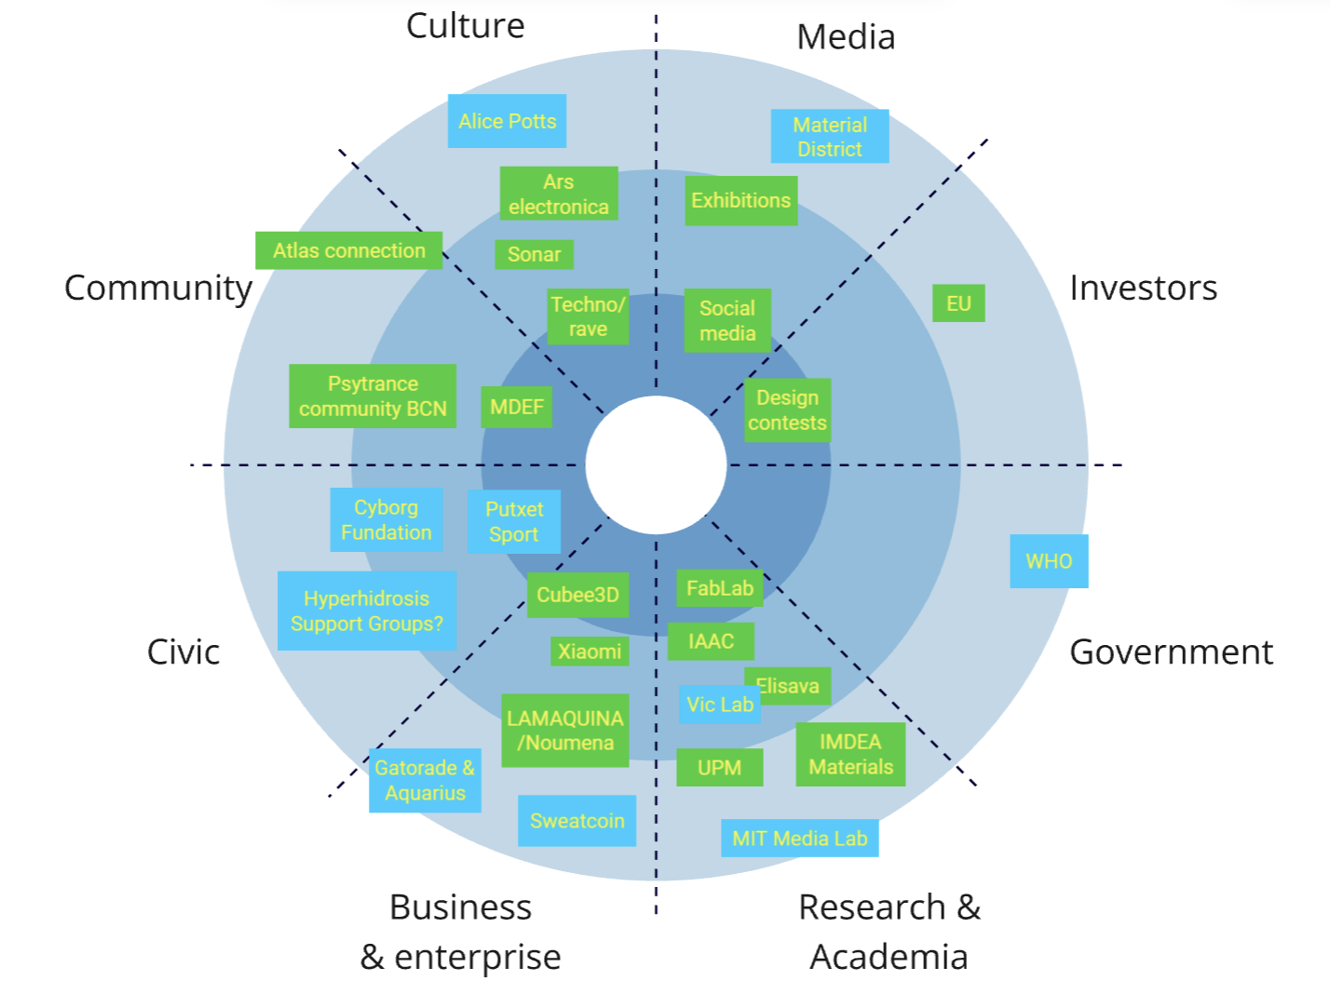
Main Stakeholders
Alice Potts
Sónar Festival
Psytrance Community BCN
IMDEA Materials
LAMAQUINA / Noumena
Gatorade / Aquarius
Putxet Sport (my gym)
Cyborg Foundation (Barcelona)

Slide 5
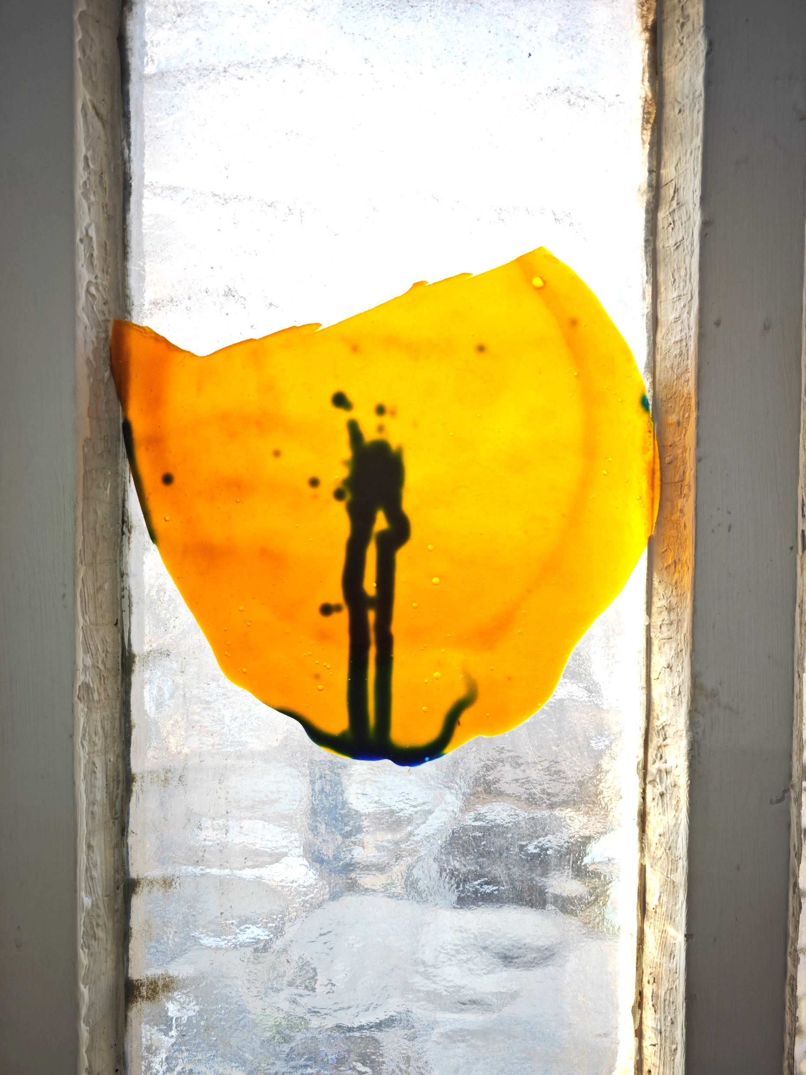
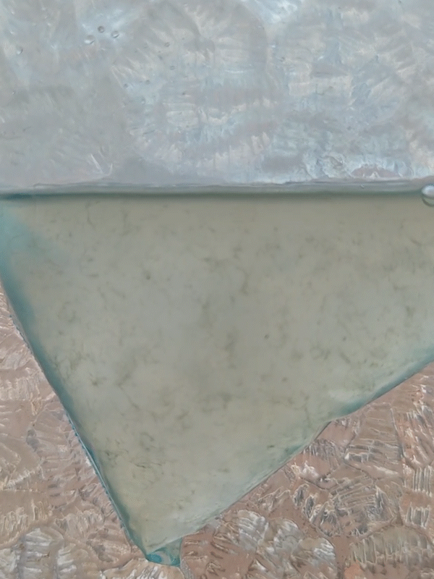
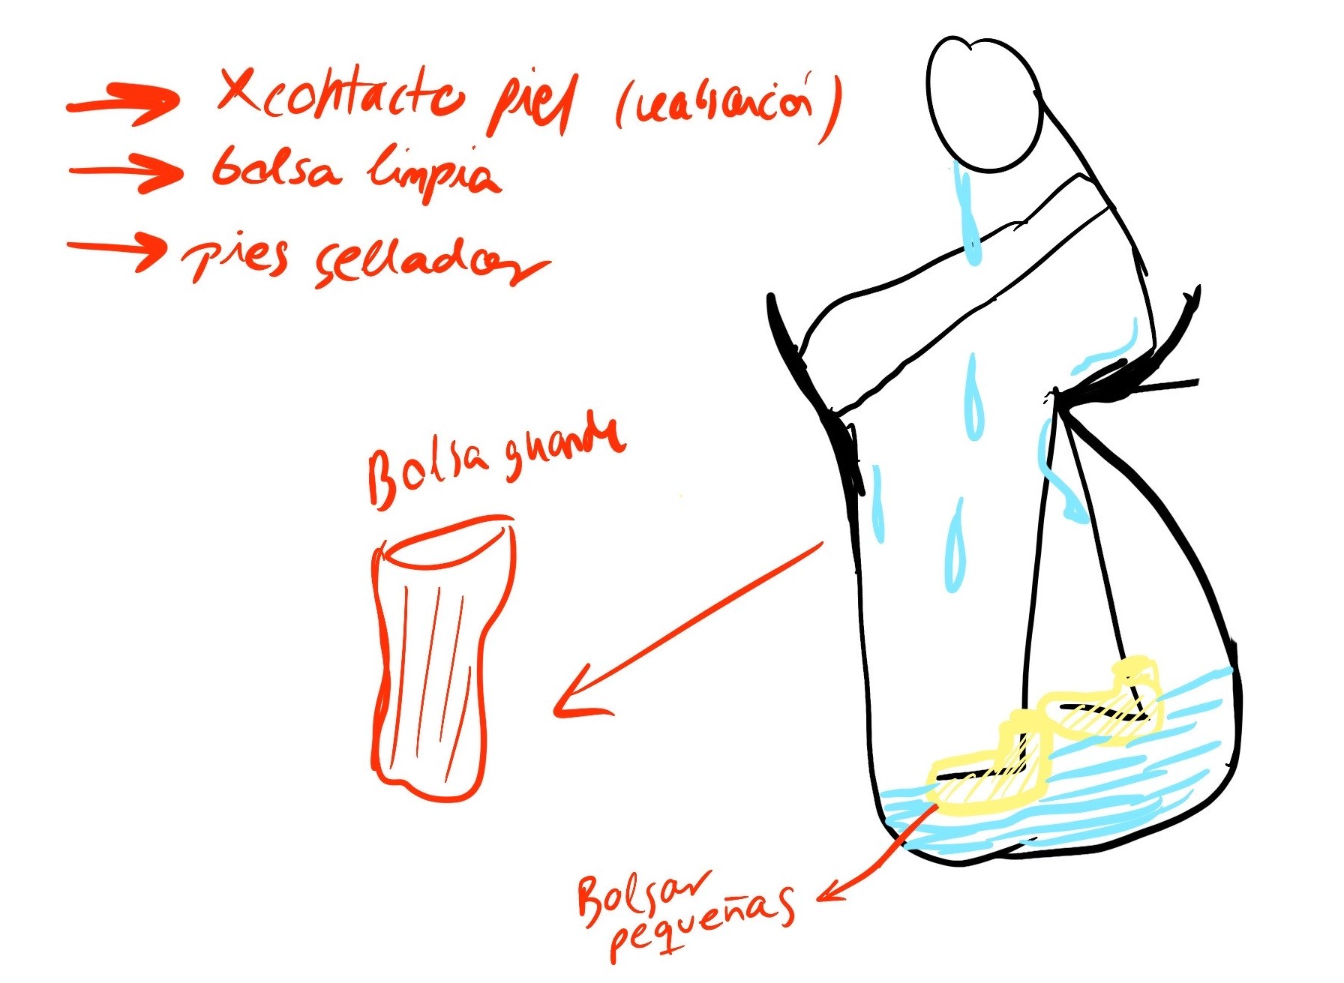
Project Definition:
Transforming sweat from an embarrassing byproduct into a valuable resource, my project explores its unique properties to foster acceptance, creativity, and innovation through wearable design, biomaterials, and human-centered experimentation.

Slide 6
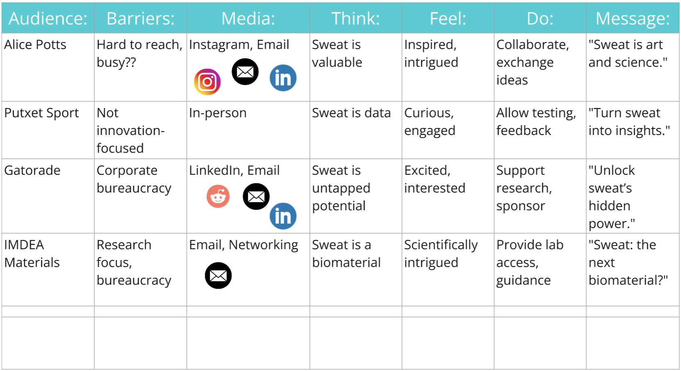
Communication Matrix:

