Slide 1

New Report

Slide 2
Perfomance header
Useful information about the performance of the model
See the performance plots below.

Slide 3
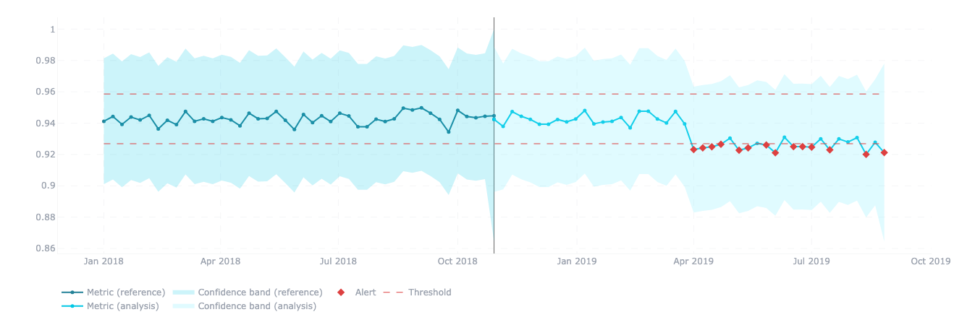
Perfomance header
F1 Estimated performance (PAPE)

Slide 4
Perfomance header
Full dataset over F1 estimated performance metric

Slide 5
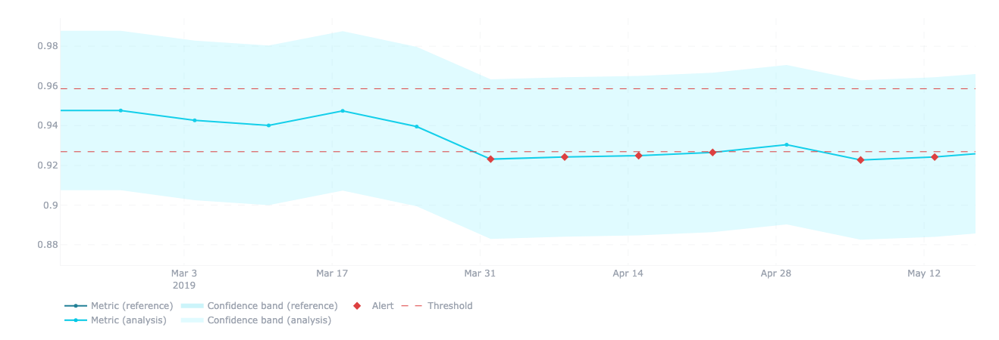
Perfomance header
F1 Estimated performance (PAPE)

Slide 6
Perfomance header
Zoom over the period from March 3rd to May 19th when a drop in performance was noted

Slide 7

Perfomance header
F1 Estimated performance (PAPE)

Slide 8
Perfomance header
The period from November 4th up to April 7th showing the state of the model in the period before the performance drop.

