Slide 1
Taking reflection in healthcare to the next level

Slide 2
[insert question]
Consider all possibilities.
So there is considerable variation in care
How to learn from this variation?
Why don’t we take a look at Formula 1 racing;
Daring decisions are made in the blink of an eye
Dramatically battling to be the best
Drivers push themselves and their machines to the very limit.
Notes:
Think about a situation that often occurs on your department, where there is variation in how you can perform the procedure / what decision can be made.
For example: You are preparing for intubation of an infant. How do you prepare with the team before the procedure?

Slide 3
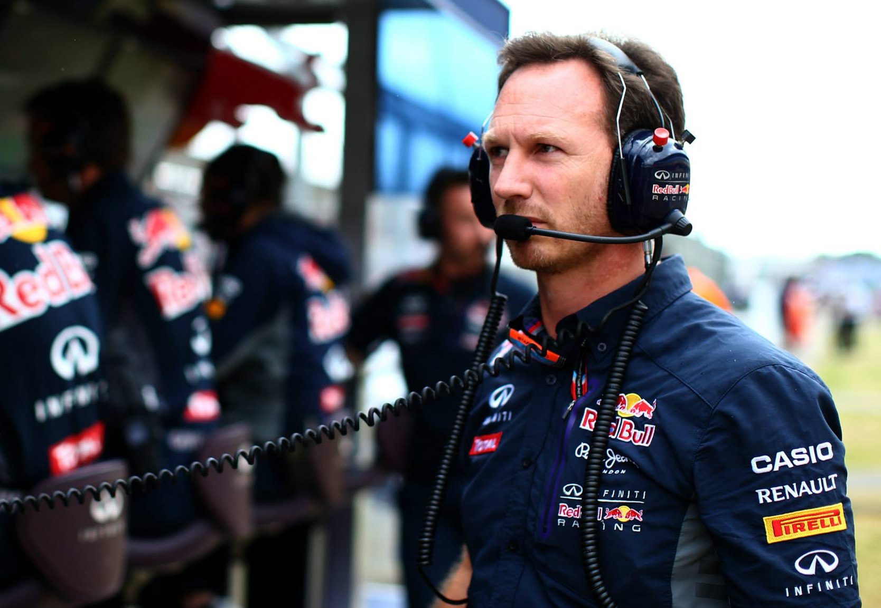
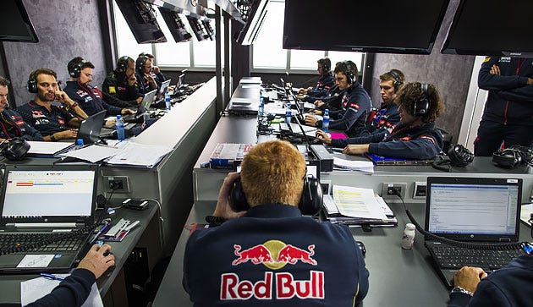
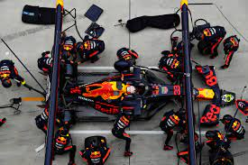
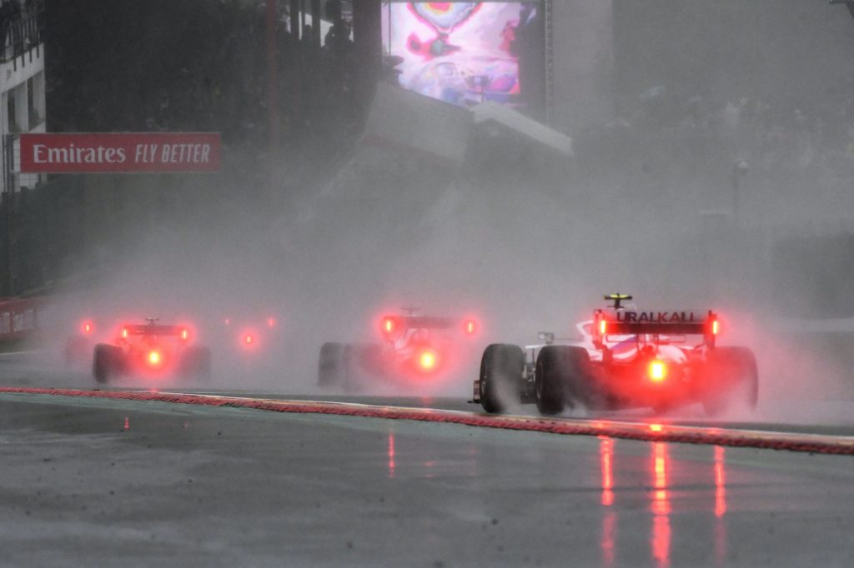
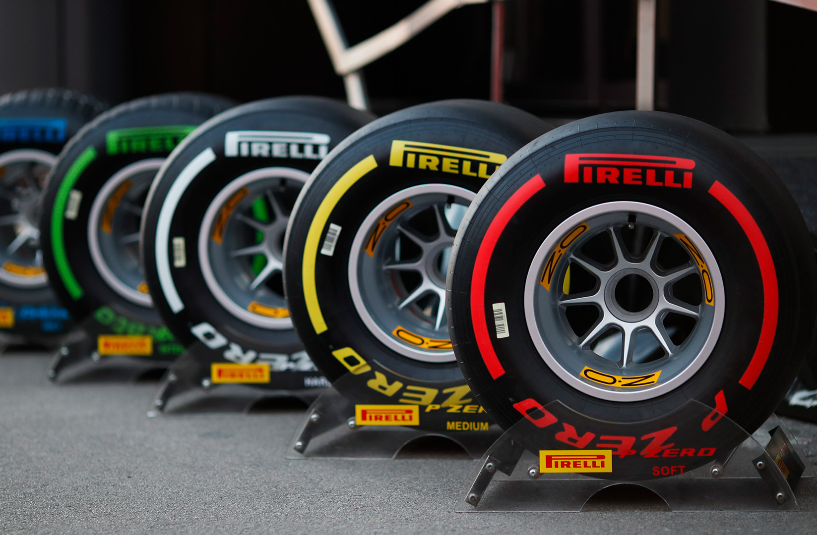
FORMULA 1
Formula 1 is one of the most data-driven sports in history
How do they keep improving?
Emergent nature
Dynamic
Lots of factors have effect on the outcome
Multidisciplinary
Debriefing of race with the engineers
Notes:
https://medium.com/the-ready/how-to-make-your-organization-as-fast-and-agile-as-a-formula-1-team-438a60f0cc38

Slide 4
FORMULA 1
What does this have to do with healthcare?
Emergent nature
Dynamic
Lots of factors have effect on the outcome
Multidisciplinary

Slide 5
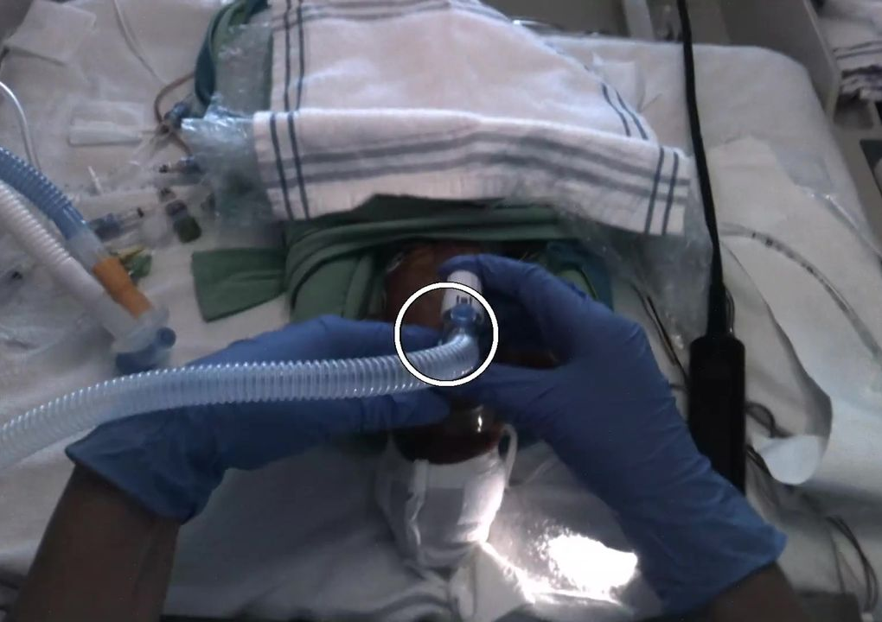
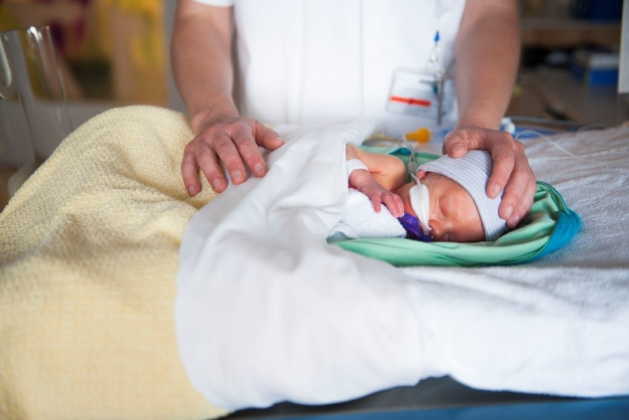
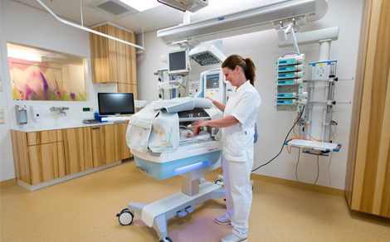
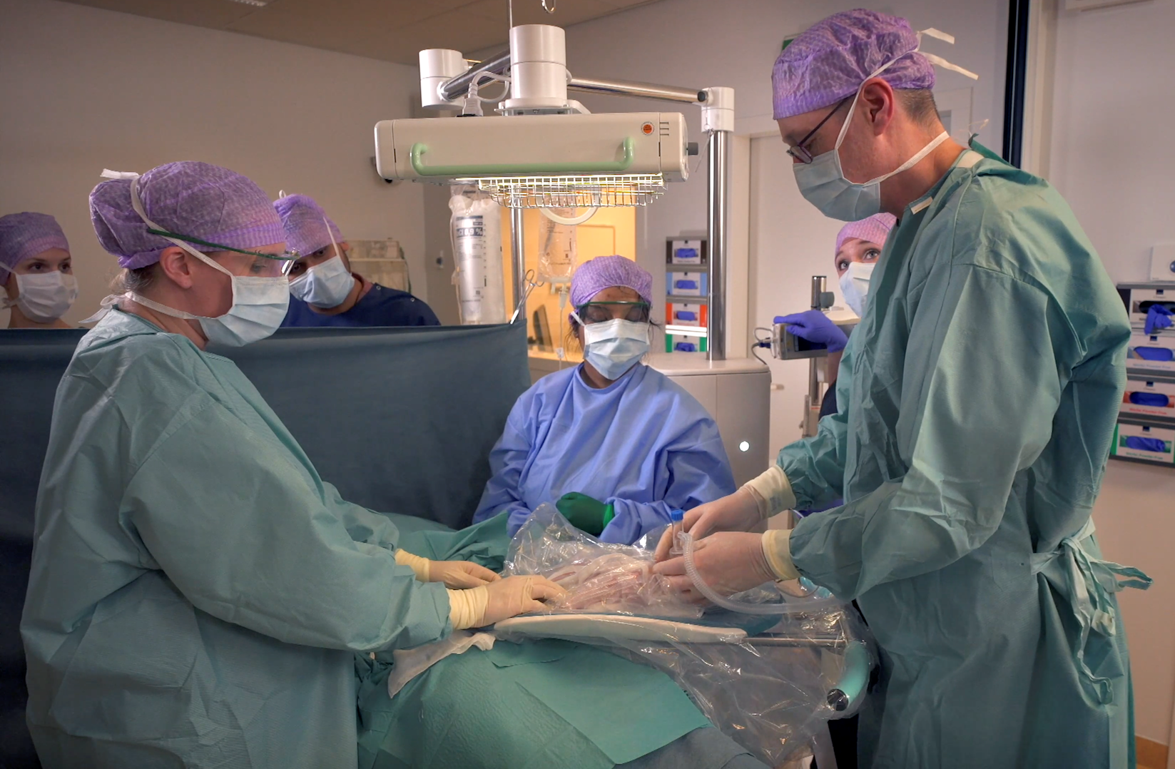
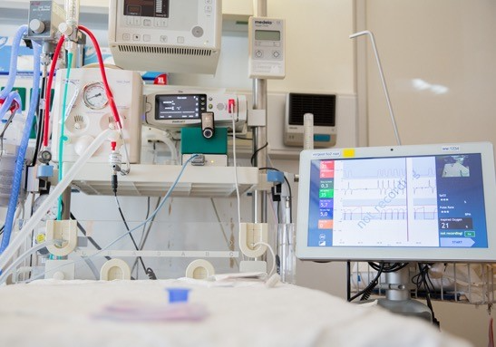
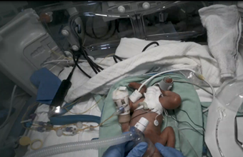
[Name of your department]
How can we keep improving?
Emergent nature
Dynamic
Lots of factors have effect on the outcome
Multidisciplinairy
Debrief or evaluation of complex procedures or acute moments
Notes:
Replace the pictures with pictures from your own department

Slide 6
How?
Involve everyone
Clarity of purpose: we want to learn from variety and improve care
No time to waste in healthcare → keep it short and effective
Full transparency of what happens during procedures
Learn from failure, but also from successes

Slide 7
Solution: video recording and reviewing of medical procedures
Continuously improve your organization by planning recurrent time to work on the organization instead of in the organization.
With all involved in hands-on care
Use videos to share procedures with full context and information
No recall-bias
Creation a no-blame culture

Slide 8
Rules of the game
Recordings are made on a voluntary basis by providers
Recordings [are / are not] part of the medical record of the patient
Recordings [are / are not] used for quality assurance purposes only, and informed consent can not be obtained from the patient due to the patient’ situation (cardiac arrest, neonatal resuscitation, severe trauma), so informed consent [is/is not] waived
Recordings are stored for [time], after which they are deleted
Note that if a mistake is made, this has te be reported, regardless of whether a video has been made
When recordings are solely used for quality assurance purposes, recordings may be legally protected

Slide 10
Safe learning environment

Slide 12
Questions?

