Slide 1
Country Engagement Implementation Framework
Notes:
Kate 3 minutes –
Introduction David Hani Marten

Slide 2
Top down approach
Bottom up approach (if started from here)
Digital Transformation Strategy
Digital Government Strategy/Policy/Roadmap
Whole-of-Government Enterprise Architecture
Service analysis/ design
Prototyping (optional in case of sandbox)
Procurement
Piloting/scaling up
- Whole-of-Society, Whole-of-Government Multisector strategy
- Vision, mission
- Ecosystem coverage
- Current situation analysis
- Stakeholders mapping
- Readiness assessment
- Vision, Mission, goals, etc.
- Ecosystem requirements (Regulatory, Workforce, infrastructure, etc.)
- Capacity gaps/requirements
- Governance
- Change Management
- Roadmap
- Outcomes, Business, Applications, Information, Integration, Security and Technical Architectures
- Services Prioritization /roadmap
- Capability/BB map (shared services)
- Compliance / adoption strategy
- Comprehensive or simplified (focusing on shared capabilities)
d
- Targeted / prioritized Stakeholders consultation
- Use cases catalogue & user journey catalogue
Business requirements gathering for prioritized services
- As-is and To-be use cases (Process simplification, reengineering)
- Might involve more than one gov. Department/ agency
- BB required
- Adapted BB specs
- Use Sandbox for prototyping based on BB reuse
- Capacity development
- Tendering support to develop or evaluate tenders if needed
- Local Ecosystem support/development
- Piloting / scaling up
- Adoption / training / change management
- Evaluation
- Impact (including green / climate)
- Replicate Sandbox if required
Capacity Building
GovStack country engagement
Scoping and Feasibility (prep step)
Current situation analysis
Stakeholders mapping
Needs Assessment / stakeholders consultation (design thinking workshop)
Validation workshop
Country engagement plan
GovStack country implementation plan
Prioritized digital services
Related ecosystem requirements (only pre-requisite factors for BB implementation)
HL Architecture/BB required (Capability / shared services map)
Capacity gaps and needs
Roadmap
How GovStack will
integrate with existing
Processes/initiatives
There are multiple possible
Entry points (any of the
above)
Deliverables

Slide 3
HoA
OUTPUT 1
STRATEGY
The strategic, technical, and regulatory prerequisites to introduce government e-services in selected countries of the Horn of Africa Region are evaluated
OUTPUT 2
E-GOVERNMENT PLATFORM
E-government building blocks are technically adapted for the use in selected member states of the Horn of Africa Region
OUTPUT 3
CAPACITY DEVELOPMENT
The technical and methodological competences of civil servants in the Horn of Africa Region to implement the e-government building blocks have been strengthened
Output Indicator 2.1
5 e-government building blocks are adapted, based on the specification of local requirements by the participating public sector entities in selected Horn of Africa member states.
Output Indicator 3.1
160 of 200 participants, 40% of the latter being women, participating in one of the three technical training mod-ules on e-government building blocks, rate the training as useful.
Output Indikator 1.1
Across selected Horn of Africa countries, 5 national government e-services with a potential for regional harmonization are identified.
Output Indicator 3.2 (Implemented by FIIAPP)
120 of 150 participants, 40% of the latter being women, participating in one of the three technical training modules on to digital change management, rate the training as useful.
Output Indikator 1.2
3 Implementation roadmaps for the introduction of national e-government services, including the piloting and roll-out phase, as well as possibilities for regional harmonization, are developed with participating public sector entities from selected Horn of Africa member states.
Output Indicator 2.2
5 e-government building blocks are freely accessible on a regional and/or national service platform (GovStack).
Output Indicator 3.3
4 cross-country communities of practice for the long-term exchange of experiences and to foster the regional digital learning have been established.

Slide 4
Countries we are currently collaborating with
Americas
Argentina
Perú
Brazil
Red GEALC
Working group on public software
Africa
Mauritania
Algeria
Rwanda
Nigeria
Sierra Leona
Kenya, HoA
Yibuti, HoA
Somalia, HoA
Assia & Pacific
PNG
Maldives
Vanuatu
Arab States
Egypt

Slide 5
Country engagement approach for Egypt
GovStack Egypt Core Team
Egypt digital ecosystem
Partner organization
eGov foundation
eGov Academy
Country team
Egypt
Hossam, Ingrid, Riham, Marcel, Karim
Digital Country team
Egypt
Companies
Expected outcomes:
Tech spec compliance
Use case – Life Event / User Journey
AHMOS Lab
EE, Korea, Ireland, Local companies (CEOs)
Internal Kick off w/Egypt team
Validate expectations
Co-define the scope of work – Tec Spec compliance, use case reference imp
Validate stakeholders for the engagement
KPIs – CoP, Kick Off, Work shop, digital service design KPIs – Tender doc, Citizen's satisfaction
Articulate the participation of the of experts from GovStack and other Government Digital Teams
Technical and product design expertise from WG
Coaching from other countries in specific topics
Kick off
Political empowerment
Technical tracks for compliance
Digital service design track

Slide 6
Partnership engagement approach for RedGealc
Country participation in working groups – Public Sofware group
Webinar – Show progress, call for constributions, present the standars
Present GovStack in Red Gealc Annual meeting – Ministerial
Nov 10 y 11
Code IDB – Implementation support to countries
Contact Lore
Show case the Red Gealc Model to other regions in the world
Advisory Board

Slide 7
Country engagement approach for Algeria
Up date Hossam
GovStack Algeria Core Team
Algeria digital ecosystem
Partner organization
MNS
Focal points
Country team
Egypt
Hossam
Digital Country team
Egypt
Companies
Expected outcomes:
Tech spec compliance
Use case – Life Event / User Journey
SYS INT
Services delivery Gov agencies
Internal Kick off to form Algeria team
Establish MNS team
Select one of the service and its focal point
Conduct Govstack training
Co-define the scope of work – Tec Spec compliance, use case reference imp
Validate stakeholders for the engagement
Articulate the participation of the of experts from GovStack and other Government Digital Teams
Technical and product design expertise from WG
Coaching from other countries in specific topics
Kick off
Political empowerment
Technical tracks for compliance
Digital service design track

Slide 8
Country engagement approach for Rwanda
GovStack Rwanda Core Team
Rwanda digital ecosystem
Partner organization
UNCTAD – eRegistration portal
Circular economy ITU
Country team
Rwanda
Concorde, Anita, Thomas, Garam
Digital Country team
Rwanda
RISA ICT Authority, RURA EPR Service Owner, Ministry of environment
TBC
Expected outcomes:
Overall GovStack TBC
Use case – EPR Process RISA, RURA Service Owner
TBC
TBC
Articulate the participation of the of experts from GovStack and other Government Digital Teams
On going
EPR Process
Technical and product design expertise from WG
TBC Internal kick off with RISA
Validate scope of the collaboration with RISA
What digital service standards shall be applied in the EPR process
Coaching from other countries in specific topics

Slide 9
Country engagement approach for Peru
GovStack Peru Core Team
Peru digital ecosystem
Expected outcomes:
Partner organization
TBC
Country team
Peru
Yola, Martha, Lac Reg Coord.
Digital Country team
Peru
Marushka Chocobar
Gob.pe advisory board
Gov Ent Dig Architecture GW3
Digital security – GW3 vSpanish
IM – Migrating national interoperability platform – Should be GovStack compliance GW
eSignature WG3 ok – DPG
WF – WG
Information consent - WG
Reference implementations on Digital services
Payment Share use cases, municipality, taxes, police user journey y service design ready, business license user journey, service design, construction license to be done while we finish tendering
Currently using wallets
Registries ok
Evaluate functionalities to be second iteration of facilita
EE
mvaldera@pcm.gob.pe
wdiaz@digital.gob.pe
Articulate the participation of the of experts from GovStack and other Government Digital Teams
Technical and product design expertise from WG
Coaching from other countries in specific topics

Slide 10
Country engagement approach for Ukraine
GovStack Ukraine Core Team
Peru digital ecosystem
Partner organization
TBC
Country team
Lena Lazzaro GIZ,
Digital Country team
Ukraine
Maxim
Expected outcomes:
TBC
TBC
TBC
Articulate the participation of the of experts from GovStack and other Government Digital Teams
Scope
Replicate the ecosystem in the govstack sandbox
GovStack compliance DPG – BPMN, Registries, app
Diia app
Portal
Training
Coaching other services - Support for countries on "Digital Services Design"
Technical and product design expertise from WG
Coaching from other countries in specific topics

Slide 11
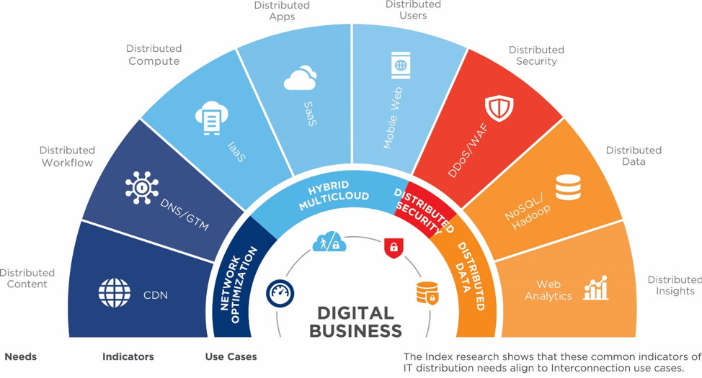
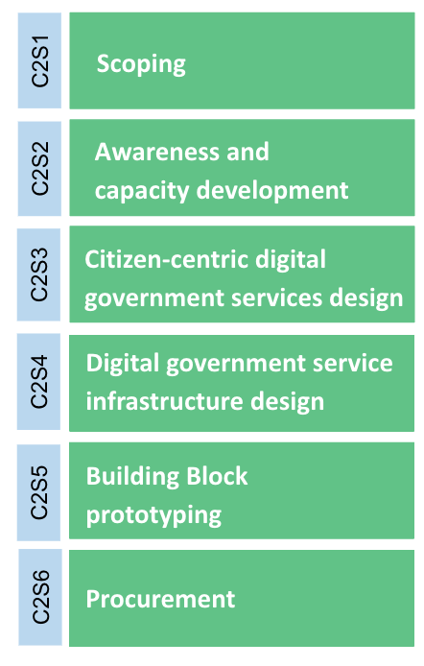
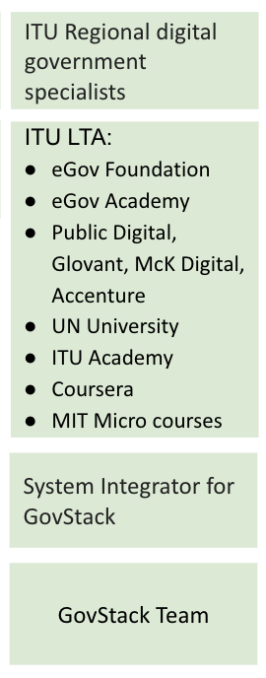
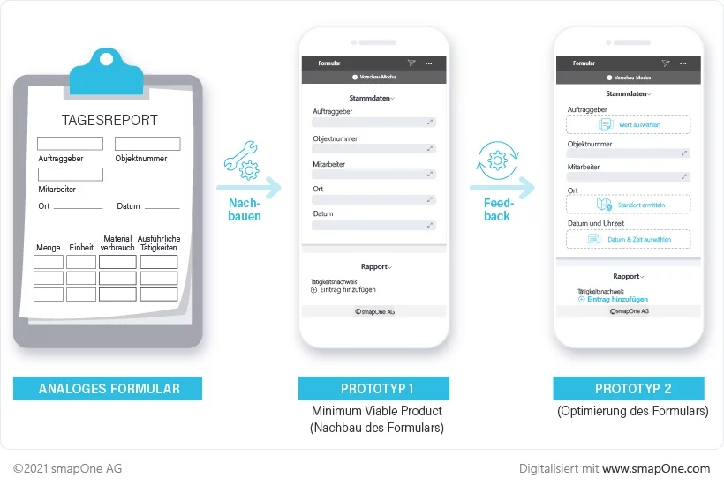
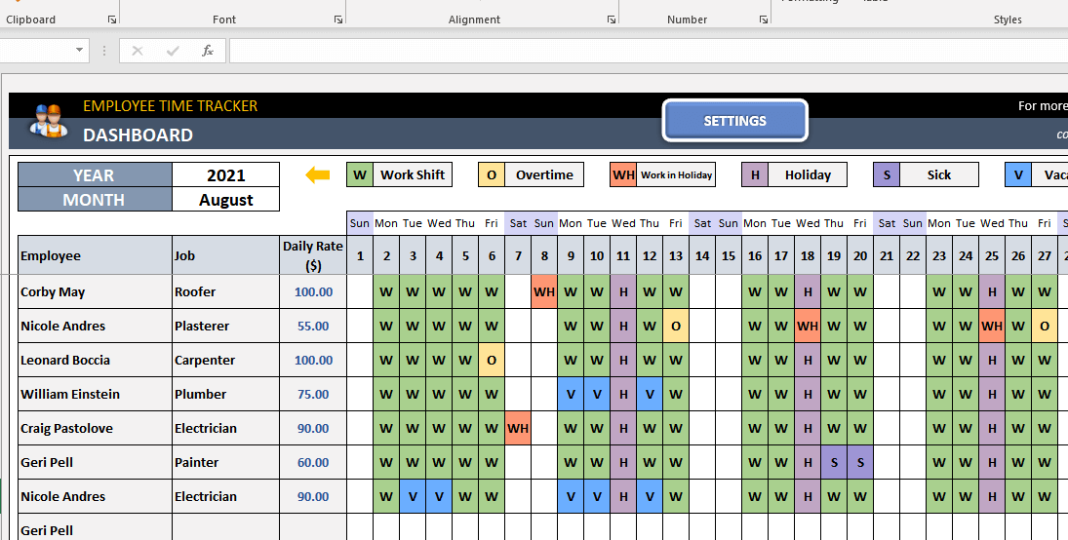
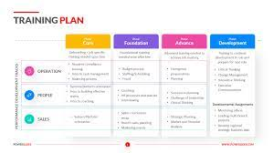
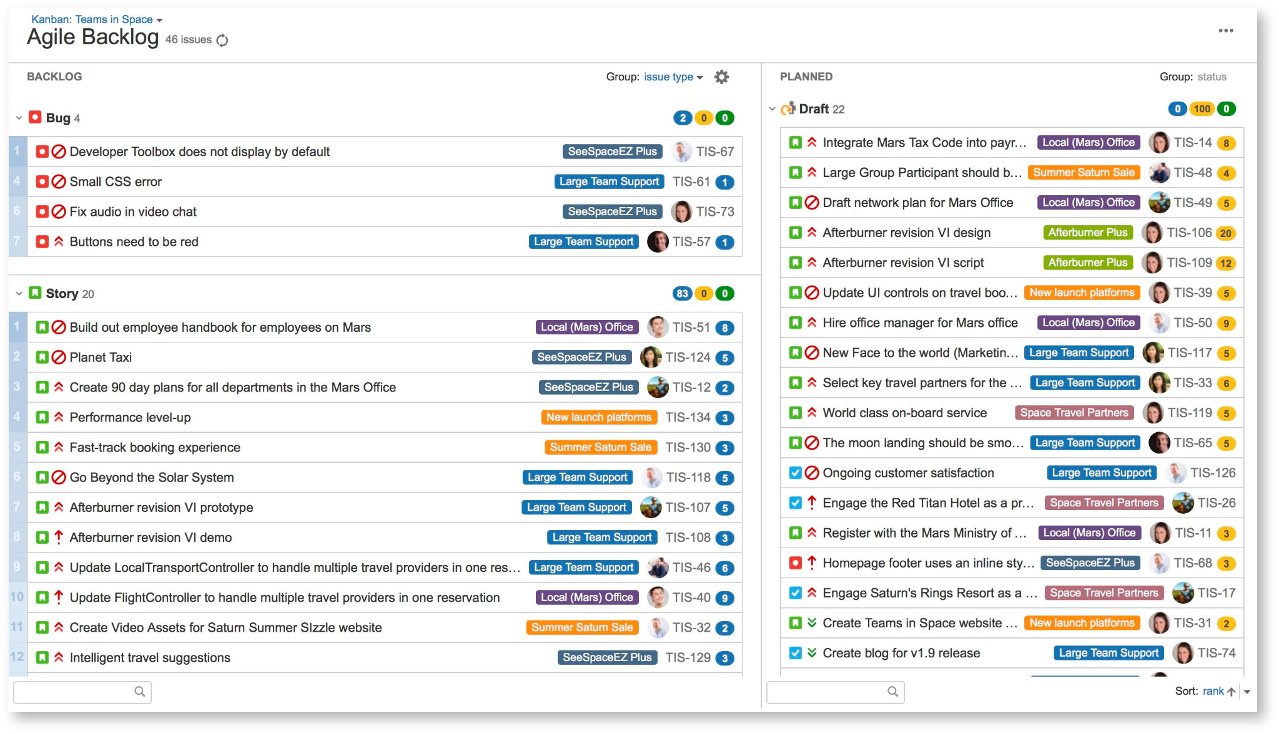
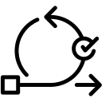
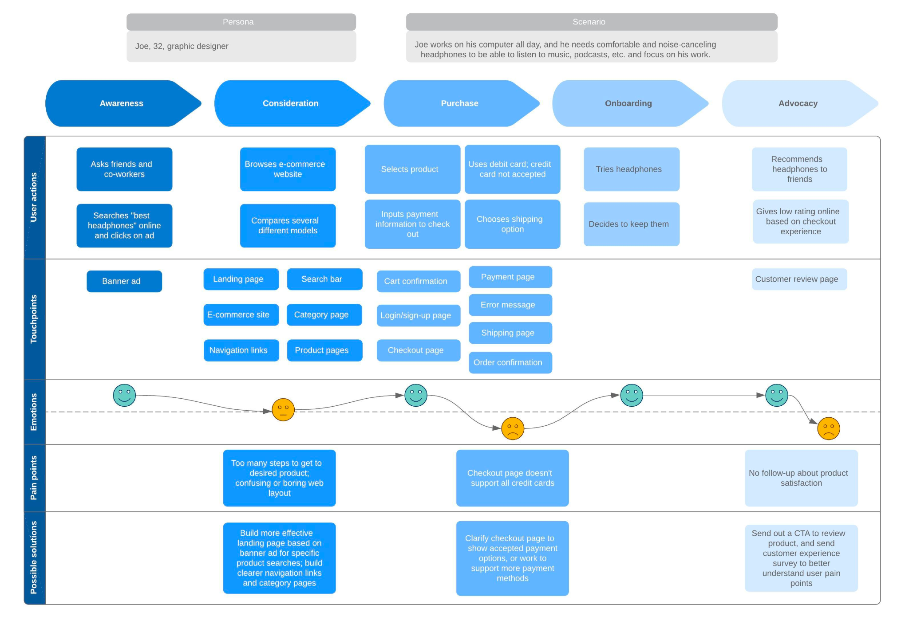
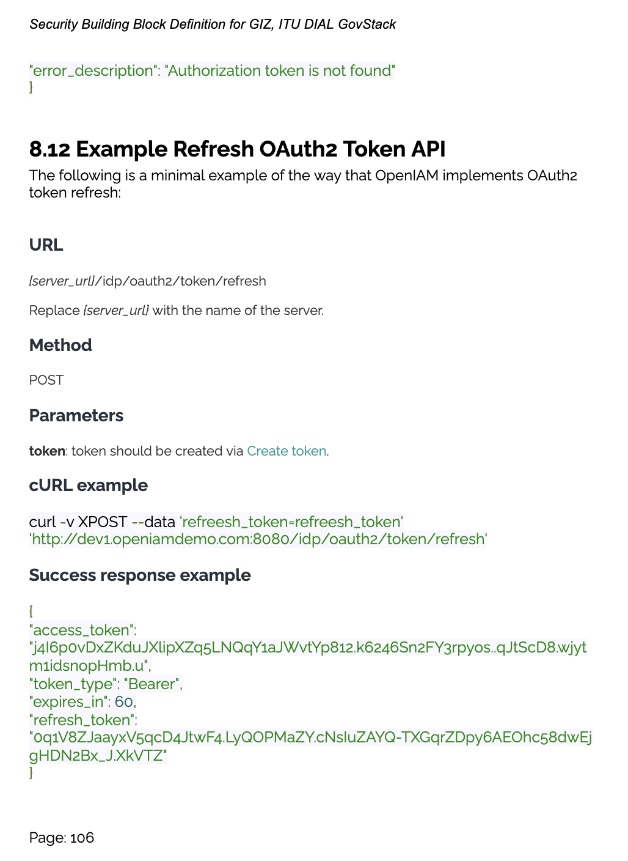
GovStack services & partner ecosystem facilitates multi country assistance in the adoption of a BB approach
Gov Stack Country Engagement Service Catalogue
Service providers
Tools & resources
Scale digital service delivery
BB Catalogue continuously updated
Use cases
Sandbox
Agile BB & use case MPVs to scale into National Gov Stack
National GovStack
Notes:
Three Components
Strategy Road Map - Political commitment DIAL
Agile Enterprise Architecture - Service design and delivery Understanding user needs, ID BB to design, MPV and delivery, SandBox, Procurement ITU
ID providers, payments,
Capacity development GIZ
Scoping step - Lets engage with Rwanda and see this tree things
Who, what, and why
Deliverable
Lists of partners - UN Agencie
Private Companies, Other Countries, LTA
2 slides for components
Country engagement framework
Target our assistance
Esp, procure and implement these capacities
Menu of services
Partners that are able to implement
Mechanisms to implement quickly
Where the gaps are
I think we need to split each component into GovStack services (to be in line with our Microservices philosophy!)
High level estimate of the cost for service
Regulation to BB activation
TdRs
Comment
same caveat: 1. don't know what policies / mechanism UNF can engage w. re. LTA / delivery MOU, 2. if that discreprancy amongst us will create any issue.

Slide 12
Exercise
Objective: Answering and developing the bullet points for each of the three components
Component 1
Strategy, Roadmap, EA, Governance​ (DIAL)​
Audience (who),
Activities/deliverables (what) and
Partners/tools from UN, NGOs, private and countries
Component 2
Digital Gov Platform based on BB​ (ITU)​
Audience (who),
Activities/deliverables (what) and
Partners/tools from UN, NGOs, private and countries
(EE)
Component 3
Capacity development​ (GIZ)​
Audience (who),
Activities/deliverables (what) and
Partners/tools from UN, NGOs, private and countries

Slide 13
Component: Strategy, Roadmap, EA, Governance (DIAL)
1

Slide 14
Strategy, Roadmap, EA, Governance
Service Offering / Menu (extrapolated from SL deck: see link) | Audience (who / what persona to be targeted in-country) | Activities / Deliverables (what to be carried out / provided) | Partners / Tools (Who to deliver or what resource / tool to be deployed + est. costing)
National Digital Development Policy | Heads of Government Ministries, Agencies and Departments | Develop effective policies that lays the foundation for better institutional coordination for digital transformation, as well as enhanced economic growth and human capital development facilitated by digital tools as critical enablers. | Altai Consulting USD 100,000
National Digital Development Strategy | Heads of Government Ministries, Agencies and Departments | Develop plan of action over the next 3-5 years to encourage adoption and development of ICT and insert selected country into information and knowledge society | Altai Consulting USD 100,000
Digital Government Roadmap | Government Ministry responsible for ICT and Digital Transformation | Develop and cost a multi-year operational roadmap for digital government projects in the next 3-5 years. It should include project description, goals, objectives, risks, stakeholders, and lead institution(s). | Yet to select a vendor USD 100,000
Enterprise Architecture | Government Ministry responsible for ICT and Digital Transformation | Develop government EA capability and a framework to address information systems interoperability and integration between government bodies at all levels. | Liranz LTD (for EA Capability) Yet to select a vendor for defining Architecture space USD 150,000 (Total for both pieces) + around 6-month span
Project Management Office | Government Ministry responsible for ICT and Digital Transformation | Institute a PMO to provide technical advisory support, timely information and domain expertise to realize key digital government initiatives. The PMO coordinates the planning, services, projects, applications, and monitoring of e-Government initiatives across the government. | DIAL
Responsible Data Use Policies and Practices | Government Ministry responsible for ICT and Digital Transformation & All MDAs handling personal data of citizenry | Develop a data governance model that incentivize responsible data practices and develop complementary regulations that enhances the strength and operationalize a country's Data Protection law | Global Advisory Services USD 120,000
Procurement Policies and Practices | Ministry of Finance & Government Ministry responsible for ICT and Digital transformation | Develop a Category Guide for Procurement of Digital (or country adaptation) which includes the costing of the digital transformation roadmap and conducting a CBA/ROI analysis of digital investments | Yet to select a vendor USD 80,000

Slide 15
Digital Government Infrastructure and Services
Notes:
Three Components
Strategy Road Map - Political commitment DIAL
Agile Enterprise Architecture - Service design and delivery Understanding user needs, ID BB to design, MPV and delivery, SandBox, Procurement ITU
ID providers, payments,
Capacity development GIZ
Scoping step - Lets engage with Rwanda and see this tree things
Who, what, and why
Deliverable
Lists of partners - UN Agencie
Private Companies, Other Countries, LTA
2 slides for components
Country engagement framework
Target our assistance
Esp, procure and implement these capacities
Menu of services
Partners that are able to implement
Mechanisms to implement quickly
Where the gaps are
I think we need to split each component into GovStack services (to be in line with our Microservices philosophy!)
High level estimate of the cost for service
Regulation to BB activation
TdRs
Comment
same caveat: 1. don't know what policies / mechanism UNF can engage w. re. LTA / delivery MOU, 2. if that discreprancy amongst us will create any issue.

Slide 16
C2: Digital Government Infrastructure and Services – Overall process and components
LTA/experts
50K/BB?
FOR EACH BB
PROTOTYPE
[GovStack System Integrator]
TRAIN
[Country specific: provider/expert]
[Global: GovStack]
SCOPE
[Regional digital government specialists + Global Product team]
In case of HoA:
[Regional digital government specialists + Global Product team + scoping experts/providers ]
ANALYZE
Use Case/Business requirements
[provider/expert]
Which BBs (1-2 max)
Which Stakeholders
Which Use Cases
Capacity Gaps
PROCURE
[GovStack team]
DESIGN
Adapted BB
[provider/expert]
Work with [Regional digital government specialists + Global Product team]
Notes:
Three Components
Strategy Road Map - Political commitment DIAL
Agile Enterprise Architecture - Service design and delivery Understanding user needs, ID BB to design, MPV and delivery, SandBox, Procurement ITU
ID providers, payments,
Capacity development GIZ
Scoping step - Lets engage with Rwanda and see this tree things
Who, what, and why
Deliverable
Lists of partners - UN Agencie
Private Companies, Other Countries, LTA
2 slides for components
Country engagement framework
Target our assistance
Esp, procure and implement these capacities
Menu of services
Partners that are able to implement
Mechanisms to implement quickly
Where the gaps are
I think we need to split each component into GovStack services (to be in line with our Microservices philosophy!)
High level estimate of the cost for service
Regulation to BB activation
TdRs
Comment
same caveat: 1. don't know what policies / mechanism UNF can engage w. re. LTA / delivery MOU, 2. if that discreprancy amongst us will create any issue.

Slide 17
C2: Digital Government Infrastructure and Services – Overall process and components
<
Component 1: Digital Government Strategy and Roadmap
<
Component 2: Digital Government Infrastructure and Services
<
Component 3: Digital Government Capacity strengthening
Notes:
Three Components
Strategy Road Map - Political commitment DIAL
Agile Enterprise Architecture - Service design and delivery Understanding user needs, ID BB to design, MPV and delivery, SandBox, Procurement ITU
ID providers, payments,
Capacity development GIZ
Scoping step - Lets engage with Rwanda and see this tree things
Who, what, and why
Deliverable
Lists of partners - UN Agencie
Private Companies, Other Countries, LTA
2 slides for components
Country engagement framework
Target our assistance
Esp, procure and implement these capacities
Menu of services
Partners that are able to implement
Mechanisms to implement quickly
Where the gaps are
I think we need to split each component into GovStack services (to be in line with our Microservices philosophy!)
High level estimate of the cost for service
Regulation to BB activation
TdRs
Comment
same caveat: 1. don't know what policies / mechanism UNF can engage w. re. LTA / delivery MOU, 2. if that discreprancy amongst us will create any issue.

Slide 18
C2: Digital Government Infrastructure and Services
SCOPE
Identify specific country needs & context, which BB(s) are required, stakeholders, identify capacity gaps, alignment of Digital Government Strategy to SGDs Digital Investment Framework.
ITU Regional digital government specialists
4 Wks
C2S1
TRAIN: Awareness raising and capacity development
Share, explain and demonstrate the GovStack specifications and make sure that gov. officials are well acquainted with it. Training could be country-specific or leveraging GovStack global training capabilities
ITU LTA or Experts:
eGov Foundation
eGov Academy
Public Digital, Glovant, McK Digital, Accenture
BB (Id, Payments, Registrations, security, etc.)
3-4 months max for 1st use case launch using BB approach
50,000 USD/Country/BB
C2S2
ANALYSE: Citizen-centric digital government services identification
Identification of high-priority use cases, As-is and to-be use cases, business requirements gathering, digital government services citizen-centric design, etc. – explicit the link with the overarching Digital Transformation and/or Digital Government strategy/Roadmap
C2S3
DESIGN: Digital government service infrastructure design
Building Block specification and adaptation, Interoperability Framework, etc. based on a Whole-of-Government Platform approach
C2S4
PROTOTYPE: Building Block prototyping
Use global or regional Govstack sandbox to prototype adapted BB, develop MVP, pilot services, learn, etc.
System Integrator for GovStack
1-2 months
C2S5
PROCURE
Support procurement process
GovStack Team
3-4 months
C2S6
C2S1
C#: Number of component, S#: Number of service within the component
Notes:
Three Components
Strategy Road Map - Political commitment DIAL
Agile Enterprise Architecture - Service design and delivery Understanding user needs, ID BB to design, MPV and delivery, SandBox, Procurement ITU
ID providers, payments,
Capacity development GIZ
Scoping step - Lets engage with Rwanda and see this tree things
Who, what, and why
Deliverable
Lists of partners - UN Agencie
Private Companies, Other Countries, LTA
2 slides for components
Country engagement framework
Target our assistance
Esp, procure and implement these capacities
Menu of services
Partners that are able to implement
Mechanisms to implement quickly
Where the gaps are
I think we need to split each component into GovStack services (to be in line with our Microservices philosophy!)
High level estimate of the cost for service
Regulation to BB activation
TdRs
Comment
same caveat: 1. don't know what policies / mechanism UNF can engage w. re. LTA / delivery MOU, 2. if that discreprancy amongst us will create any issue.

Slide 19
C2: Digital Government Infrastructure and Services
Scoping
Identify specific country needs & context, which BB(s) are required, stakeholders, alignment of Digital Government Strategy to SGDs Digital Investment Framework.
C2S1
Audience (to whom this service is targeted):
eGov Authorities
Digital Infrastructure Teams CTOs
Digital Security Teams
Central Digital Service Teams
Registry Authorities (ID)
Digital Service Teams within a Public Entity
Activities (in bullet points):
Apply Country Needs & Assessment Questionnaire (DRAs)
Conduct 1-1 interviews & workshops with key stakeholders and authorities to identify BB required
Map the Digital Government Strategy to the SGDs Digital Investment Framework.
Identify first 1-2 priority BB to start with
Deliverables:
Country digital context and needs report
Catalogue of BB & stakeholders involved in their implementation, BB investment strategy and requirements
Notes:
Three Components
Strategy Road Map - Political commitment DIAL
Agile Enterprise Architecture - Service design and delivery Understanding user needs, ID BB to design, MPV and delivery, SandBox, Procurement ITU
ID providers, payments,
Capacity development GIZ
Scoping step - Lets engage with Rwanda and see this tree things
Who, what, and why
Deliverable
Lists of partners - UN Agencie
Private Companies, Other Countries, LTA
2 slides for components
Country engagement framework
Target our assistance
Esp, procure and implement these capacities
Menu of services
Partners that are able to implement
Mechanisms to implement quickly
Where the gaps are
I think we need to split each component into GovStack services (to be in line with our Microservices philosophy!)
High level estimate of the cost for service
Regulation to BB activation
TdRs
Comment
same caveat: 1. don't know what policies / mechanism UNF can engage w. re. LTA / delivery MOU, 2. if that discreprancy amongst us will create any issue.

Slide 20
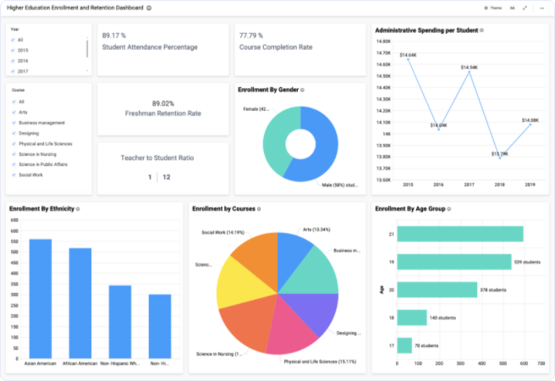
C2: Digital Government Infrastructure and Services
Awareness and capacity development
Share, explain and demonstrate the GovStack specifications and make sure that gov. officials and usa case stakeholders are well acquainted with it.
C2S2
Audience (to whom this service is targeted):
eGov Authorities
Digital Infrastructure Teams CTOs
Digital Security Teams
Registry Authorities (ID)
Central Digital Service Teams
Digital Service Teams within a Public Entity
Researchers + PhDs candidates
Think tanks
eGov NGOs
Other UN Agencies
Activities (in bullet points):
co-Design the capacity development program with key country authorities using the GovStack Capacity Development Toolkit?
Run GovStack Capacity Development country specific workshops
Conduct GovStack generic capacity development programs (optional)
Organize graduation ceremony with GovStack Partners and Gov Authorities
Deliverables:
Capacity Development Plan
GovStack workshops
Course statistics, grades & course evaluations uploaded in GovStack Training Platform?
Notes:
Three Components
Strategy Road Map - Political commitment DIAL
Agile Enterprise Architecture - Service design and delivery Understanding user needs, ID BB to design, MPV and delivery, SandBox, Procurement ITU
ID providers, payments,
Capacity development GIZ
Scoping step - Lets engage with Rwanda and see this tree things
Who, what, and why
Deliverable
Lists of partners - UN Agencie
Private Companies, Other Countries, LTA
2 slides for components
Country engagement framework
Target our assistance
Esp, procure and implement these capacities
Menu of services
Partners that are able to implement
Mechanisms to implement quickly
Where the gaps are
I think we need to split each component into GovStack services (to be in line with our Microservices philosophy!)
High level estimate of the cost for service
Regulation to BB activation
TdRs
Comment
same caveat: 1. don't know what policies / mechanism UNF can engage w. re. LTA / delivery MOU, 2. if that discreprancy amongst us will create any issue.

Slide 21
C2: Digital Government Infrastructure and Services
Citizen-centric digital gov services design
As-is and to-be use cases, business requirements gathering, digital government services design, etc. – explicit the link with the overarching Digital Transformation and/or Digital Government strategy/Roadmap
C2S3
Audience (to whom this service is targeted):
eGov Authorities
Central Digital Service Teams
Digital Service Teams within a Public Entities at all levels of government
Activities (in bullet points):
User needs assessment,
Business requirements gathering,
Digital government services design with explicit link with the overarching Digital Transformation and/or Digital Government strategy/Roadmap
Deliverable:
As-Is, To-Be user journey
Functional requirements
Notes:
Three Components
Strategy Road Map - Political commitment DIAL
Agile Enterprise Architecture - Service design and delivery Understanding user needs, ID BB to design, MPV and delivery, SandBox, Procurement ITU
ID providers, payments,
Capacity development GIZ
Scoping step - Lets engage with Rwanda and see this tree things
Who, what, and why
Deliverable
Lists of partners - UN Agencie
Private Companies, Other Countries, LTA
2 slides for components
Country engagement framework
Target our assistance
Esp, procure and implement these capacities
Menu of services
Partners that are able to implement
Mechanisms to implement quickly
Where the gaps are
I think we need to split each component into GovStack services (to be in line with our Microservices philosophy!)
High level estimate of the cost for service
Regulation to BB activation
TdRs
Comment
same caveat: 1. don't know what policies / mechanism UNF can engage w. re. LTA / delivery MOU, 2. if that discreprancy amongst us will create any issue.

Slide 22
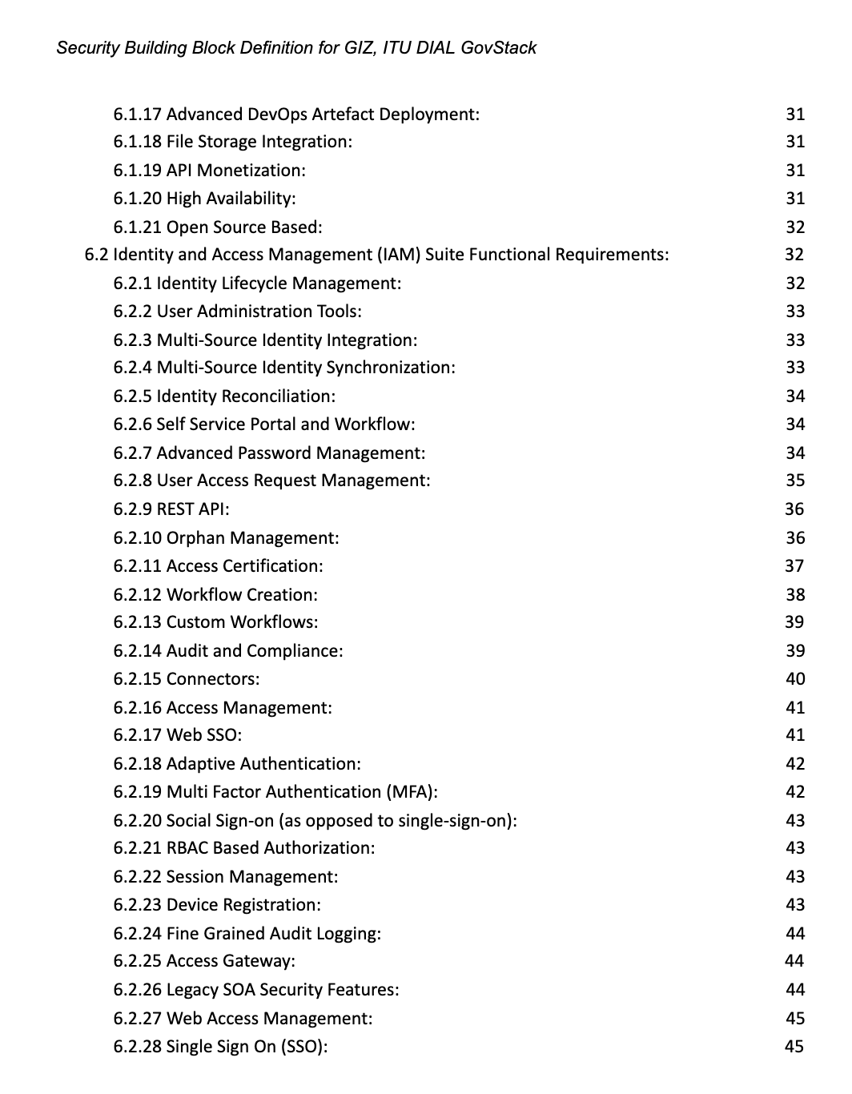
C2: Digital Government Infrastructure and Services
Digital government service infrastructure design
Building Blocks specification and adaptation to Country National Stack and a whole-of-government platform approach
C2S4
Audience (to whom this service is targeted):
eGov Authorities
Digital Infrastructure Teams CTOs
Digital Security Teams
Registry Authorities (ID)
Central Digital Service Teams
Digital Service Teams within a Public Entity
Activities (in bullet points):
Adapt GovStack BB specifications to National GovStack
Ensure integration with other Stack BB
Deliverables:
BB specifications
Notes:
Three Components
Strategy Road Map - Political commitment DIAL
Agile Enterprise Architecture - Service design and delivery Understanding user needs, ID BB to design, MPV and delivery, SandBox, Procurement ITU
ID providers, payments,
Capacity development GIZ
Scoping step - Lets engage with Rwanda and see this tree things
Who, what, and why
Deliverable
Lists of partners - UN Agencie
Private Companies, Other Countries, LTA
2 slides for components
Country engagement framework
Target our assistance
Esp, procure and implement these capacities
Menu of services
Partners that are able to implement
Mechanisms to implement quickly
Where the gaps are
I think we need to split each component into GovStack services (to be in line with our Microservices philosophy!)
High level estimate of the cost for service
Regulation to BB activation
TdRs
Comment
same caveat: 1. don't know what policies / mechanism UNF can engage w. re. LTA / delivery MOU, 2. if that discreprancy amongst us will create any issue.

Slide 23
C2: Digital Government Infrastructure and Services
Building Block prototyping
Use global or regional Govstack sandbox to prototype adapted BB, develop MVP, pilot services and iterate with users, execute learning exercises.
C2S5
Audience (to whom this service is targeted):
eGov Authorities
Digital Infrastructure Teams CTOs
Digital Security Teams
Registry Authorities (ID)
Central Digital Service Teams
Digital Service Teams within a Public Entity
Researchers + PhDs candidates
Think tanks
Other UN Agencies
eGov NGOs
Activities (in bullet points):
Prototype adapted BB
Develop MVP
Pilot digital services in GovStack SandBox
Iterate with digital service users
Measure user satisfaction with the service
Measure impacts & benefits of the service design BB approach using BB business case template
Deliverables:
MVP
Test scripts for piloting MPV with users
User satisfaction report
Impact & benefit analysis
Notes:
Three Components
Strategy Road Map - Political commitment DIAL
Agile Enterprise Architecture - Service design and delivery Understanding user needs, ID BB to design, MPV and delivery, SandBox, Procurement ITU
ID providers, payments,
Capacity development GIZ
Scoping step - Lets engage with Rwanda and see this tree things
Who, what, and why
Deliverable
Lists of partners - UN Agencie
Private Companies, Other Countries, LTA
2 slides for components
Country engagement framework
Target our assistance
Esp, procure and implement these capacities
Menu of services
Partners that are able to implement
Mechanisms to implement quickly
Where the gaps are
I think we need to split each component into GovStack services (to be in line with our Microservices philosophy!)
High level estimate of the cost for service
Regulation to BB activation
TdRs
Comment
same caveat: 1. don't know what policies / mechanism UNF can engage w. re. LTA / delivery MOU, 2. if that discreprancy amongst us will create any issue.

Slide 24
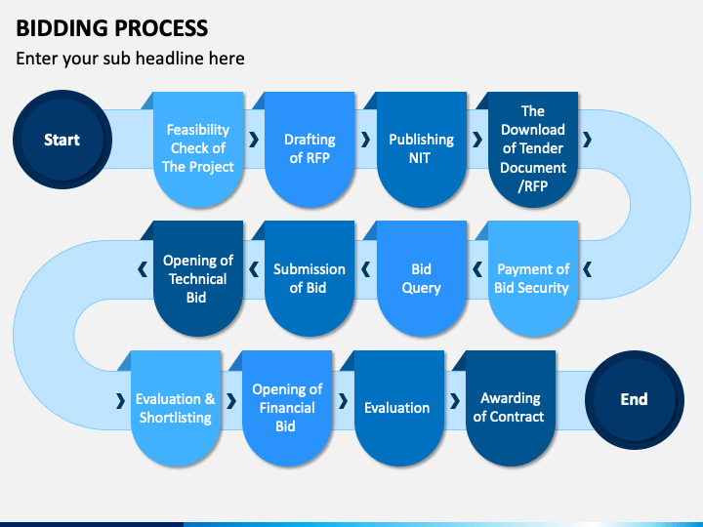
C2: Digital Government Infrastructure and Services
Support BB procurement process
C2S6
Procurement
Audience (to whom this service is targeted):
eGov Authorities
Digital Infrastructure Teams CTOs
Digital Security Teams
Registry Authorities (ID)
Central Digital Service Teams
Digital Service Teams within a Public Entity
Activities (in bullet points):
Assess ICT procurement ecosystem
Analize procurement regulatory framework
Make recommendations for BB procurement guidelines
Integrate Green Procurement measures
Accompany procurement process
Deliverables:
BB Procurement guidelines considering green stack procurement principles
Country Procurement documents developed (if needed)
Regulatory reform recommendations when applicable
Notes:
Three Components
Strategy Road Map - Political commitment DIAL
Agile Enterprise Architecture - Service design and delivery Understanding user needs, ID BB to design, MPV and delivery, SandBox, Procurement ITU
ID providers, payments,
Capacity development GIZ
Scoping step - Lets engage with Rwanda and see this tree things
Who, what, and why
Deliverable
Lists of partners - UN Agencie
Private Companies, Other Countries, LTA
2 slides for components
Country engagement framework
Target our assistance
Esp, procure and implement these capacities
Menu of services
Partners that are able to implement
Mechanisms to implement quickly
Where the gaps are
I think we need to split each component into GovStack services (to be in line with our Microservices philosophy!)
High level estimate of the cost for service
Regulation to BB activation
TdRs
Comment
same caveat: 1. don't know what policies / mechanism UNF can engage w. re. LTA / delivery MOU, 2. if that discreprancy amongst us will create any issue.

Slide 25
Component: Capacity development (GIZ)
3

Slide 26
Capacity Building: Target Group & Activities
Target Group
Government Officials
Political Decision Makers
Policy Advisors
Technical Experts
Activities
(Workshops, E-Learning)
GovStack
GovTech
Global Community
Whole-of-Government Approach
Green Stack
Open Source Solutions
Digital Public Goods
Building Blocks
Interoperability
Digital Accessibility & Inclusiveness
Financing
Digital Risk Management
Data Protection
Privacy
Cybersecurity
Procurement
Microprocurements
Digital/ Change Management
Digital Skills
Design & set up of dig. teams
DIAL Solutions Catalog
Model Reference Plattform
= conducted within GovStack
Use Case Development
Sandbox Environment
Building Block Approach
= conducted externally
Testing
Prototype

Slide 27
C3: Capacity Development
Awareness and capacity development
Share, explain and demonstrate e-government, whole-of-government approach and the GovStack specifications with government officials and authorities.
Audience (to whom this service is targeted):
eGov Authorities
Government officials
Digital Service Teams within a Public Entity
Researchers + PhDs candidates
Think tanks
eGov NGOs
Other UN Agencies
Activities (in bullet points):
Needs Assessments / Status Quo Assessments (e.g., including DEI)
co-Design the capacity development program with key country authorities using the GovStack Capacity Development
Provide e-learnings on: GovStack and whole of government approach
Run GovStack Capacity Development country specific workshops
Data Gathering of workshops
Content Partnership (UNDP, Harvard Kennedy School)
Deliverables:
Needs Assessments in partner countries
Capacity Development Plan
Capacity Development e-learnings (GovStack, Whole of Government, GreenStack..)
Capacity Development courses
Notes:
Three Components
Strategy Road Map - Political commitment DIAL
Agile Enterprise Architecture - Service design and delivery Understanding user needs, ID BB to design, MPV and delivery, SandBox, Procurement ITU
ID providers, payments,
Capacity development GIZ
Scoping step - Lets engage with Rwanda and see this tree things
Who, what, and why
Deliverable
Lists of partners - UN Agencie
Private Companies, Other Countries, LTA
2 slides for components
Country engagement framework
Target our assistance
Esp, procure and implement these capacities
Menu of services
Partners that are able to implement
Mechanisms to implement quickly
Where the gaps are
I think we need to split each component into GovStack services (to be in line with our Microservices philosophy!)
High level estimate of the cost for service
Regulation to BB activation
TdRs
Comment
same caveat: 1. don't know what policies / mechanism UNF can engage w. re. LTA / delivery MOU, 2. if that discreprancy amongst us will create any issue.

Slide 28
C3: Capacity Development
Roadmap development
Jointly work on the development of roadmaps for the poltical integration of the GovStack approach.
Audience (to whom this service is targeted):
eGov Authorities
Government Officials
Digital Infrastructure Teams CTOs
Digital Service Teams within a Public Entity
Activities (in bullet points):
Co-Design national roadmaps with key actors based on needs asessment and capacity development activities
Political consultancy to develop roadmap for national integration
CD on how to set up digital service teams
CD on how to design a digital service
Deliverables:
National Political Assessment
Written Roadmaps and Integration Plans
Notes:
Three Components
Strategy Road Map - Political commitment DIAL
Agile Enterprise Architecture - Service design and delivery Understanding user needs, ID BB to design, MPV and delivery, SandBox, Procurement ITU
ID providers, payments,
Capacity development GIZ
Scoping step - Lets engage with Rwanda and see this tree things
Who, what, and why
Deliverable
Lists of partners - UN Agencie
Private Companies, Other Countries, LTA
2 slides for components
Country engagement framework
Target our assistance
Esp, procure and implement these capacities
Menu of services
Partners that are able to implement
Mechanisms to implement quickly
Where the gaps are
I think we need to split each component into GovStack services (to be in line with our Microservices philosophy!)
High level estimate of the cost for service
Regulation to BB activation
TdRs
Comment
same caveat: 1. don't know what policies / mechanism UNF can engage w. re. LTA / delivery MOU, 2. if that discreprancy amongst us will create any issue.

Slide 29
C3: Capacity Development
Cooperation and Sustainability
Create a global community to share best-practices, experiences and learn from each other.
Audience (to whom this service is targeted):
eGov Authorities
Government Officials
Digital Infrastructure Teams CTOs
Digital Service Teams within a Public Entity
Researchers + PhDs candidates
Think tanks
eGov NGOs
Other UN Agencies
Activities (in bullet points):
Collect best-practices and create best practice repository
Involve key actors in working groups, technical review committee (TRC) and existing communities of practice (CoP)
Establish additional CoP to ensure the quality of the GovStack Initiatives work
Organize CDO (Digital Leaders Forum) exchange jointly with DIAL
Create an online forum and dicussion for the online community
Activate local software developers (focus on female developers) through innovative formats
Deliverables:
Best Practice Repository (e.g., videos/interviews showcasing approaches in India, Singapore, Estonia etc)
Additional info material (e.g., 3 videos on the GovStack Approach)
Active member in WG, TRC and CoP
3 Communities of Practice
Bi-annualy CDO exchange
Local innovation format to engage software developer community
Notes:
Three Components
Strategy Road Map - Political commitment DIAL
Agile Enterprise Architecture - Service design and delivery Understanding user needs, ID BB to design, MPV and delivery, SandBox, Procurement ITU
ID providers, payments,
Capacity development GIZ
Scoping step - Lets engage with Rwanda and see this tree things
Who, what, and why
Deliverable
Lists of partners - UN Agencie
Private Companies, Other Countries, LTA
2 slides for components
Country engagement framework
Target our assistance
Esp, procure and implement these capacities
Menu of services
Partners that are able to implement
Mechanisms to implement quickly
Where the gaps are
I think we need to split each component into GovStack services (to be in line with our Microservices philosophy!)
High level estimate of the cost for service
Regulation to BB activation
TdRs
Comment
same caveat: 1. don't know what policies / mechanism UNF can engage w. re. LTA / delivery MOU, 2. if that discreprancy amongst us will create any issue.

Slide 30
Capacity Building: Potential Implementing Partner
Implementing Partner
Global
Local & regional
eGovernance Academy
Digital Africa
Simply Secure
Center of Digital Excellence (CODE)
MercyCorps
KICTANet
Creative Associates International
Africa Institute for Capacity Development
Caribou Digital
Toolkit iSkills
UN Organizations
Gebeya
Oxford Digital Pathways
Somali Institute For Development Research And Analysis - SIDRA
→ See full list of potential implementing partners here

