Slide 1
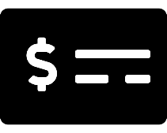
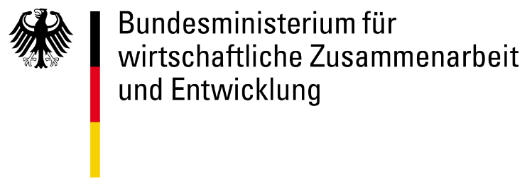
Accelerating the digital transformation of government services
Notes:
Kate 3 minutes –
Introduction David Hani Marten

Slide 2
Table of contents
1
2
3
4
Motivation
Challenges and progress in transformation of government services.
Concept
Model of a holistic digital government platform setup with Building Blocks, with diverse country models and perceived / tangible benefits
Approach
Bringing the technical approach to life.
Joining Us
Get involved. Stay engaged. Partner up. Shape future.

Slide 3
Motivation
1

Slide 4
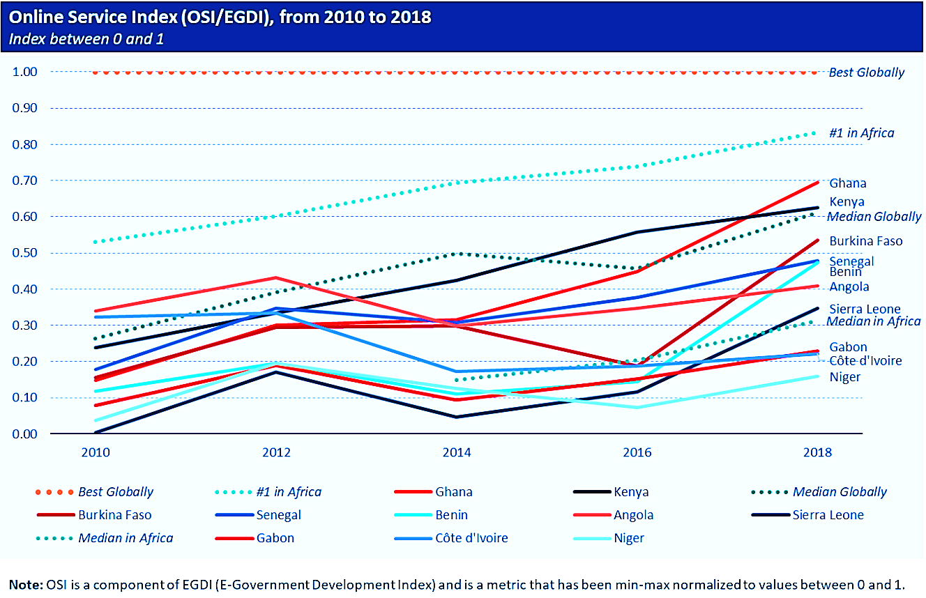
Governments in developing countries are all on a progressive pathway to digitize service delivery. Not all are without struggles.
Coordination: Problems in coordination commonly occur in aligning ICT ministry work with that of other agencies.
Siloes: Siloed investments and duplicative efforts by development partners create fragmented digital governance in partner countries.
Funding: Challenges in procuring and implementing affordable IT solutions persist, as do challenges in finding the necessary capital to invest in ICT infrastructure projects.
Scaling: Major challenges exist in adapting and investing in projects at scale, particularly in the rollout of physical ICT infrastructure, and deployment and use of common data platforms.
Continuous but disparate digital service provision progress across selected countries [source: DIAL Listening Study]

Slide 5
All governments need to grapple with a range of challenges as they digitally transform
Lack of updated and comprehensive national ICT plans with KPIs and timetables
Limited financing and procurement for ICT projects
Limited coordination of ICT strategy implementation across government
Lack of interoperability frameworks in systems leading to siloed approaches
To come: Most directly relevant and addressable by GovStack
Ineffective governance and institutional frameworks to steer digital transformation efforts
Human capacity, digital literacy, and limited competencies amongst the workforce
Limited access to infrastructure across the country, affordability and internet access
Limited cross-border integration of systems and regulatory frameworks
[source: DIAL Listening Study]

Slide 6
With few illustrative examples as seen in countries around the world.
Madagascar
Coordination across sectors and ministries had been a major challenge in Madagascar because of a lack of a harmonized vision, prohibiting realization of effective and transformative digital government in the country.
Despite a large pool of software developer talent, a burgeoning tech industry, and broadband speeds among the fastest in Africa [Public Digital], e-government rankings have been consistently low (#172) while there have been substantial gains in connectivity and private sector development. [UNDESA]
The hiring of a Chief Digital Officer and the development of digital transformation and e-governance roadmaps helped the government to put effective coordination and governance back at the forefront. [Public Digital]
This was supported with funding and collaboration from partners like the World Bank to improve government capacity and capabilities, as well as strengthen sectoral service delivery. [World Bank]
Ethiopia
Silo-ing has been recognized by the Government of Ethiopia as a problem for rolling out its first attempt at CRVS via the Vital Events Registration Agency (VERA) [UNICEF Ethiopia] in its Digital Ethiopia 2030 strategy. The system struggled to adapt the kebele ID system to digital without having robust digital infrastructure to manage it. [Word Bank ID4D]
A diagnostic assessment by Pathways for Prosperity helped the government to recognize silos leading to increased costs to individuals, causing inconvenience to underserved populations, as well as creating a burden on government through having different service providers with different requirements. [Digital Ethiopia 2030]
As a result, their new digital economy strategy has been developed focusing on digital ID as a core enabling system to help overcome silos. [Digital Ethiopia 2030] The government is currently in the process of trying to implement a new system [New Business Ethiopia], supported by MOSIP. [Biometric Update]

Slide 7
Concept
2

Slide 8
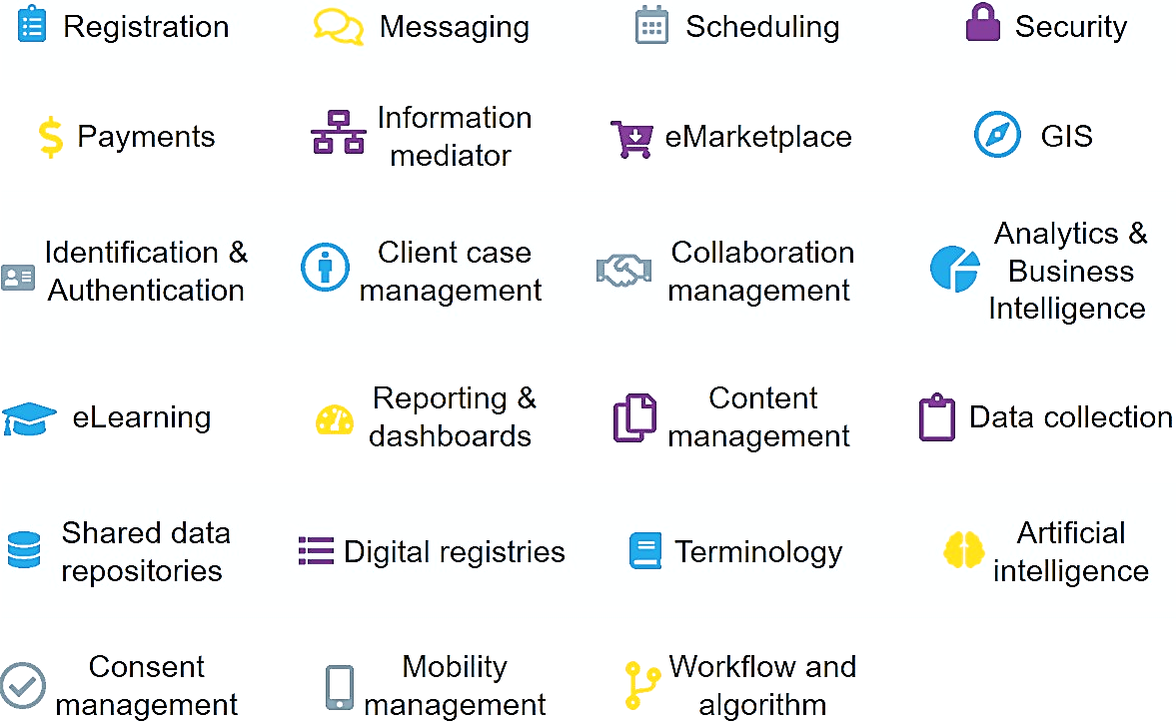
We believe there is a solution through the creation of generic Building Blocks.
What are Building Blocks?
Generically-defined software components that in combination provide key functionalities to facilitate generic workflows common across multiple sectors.
What are their characteristics?
Reusable software components​
Open-source, commercial off-the-shelf (COTS), or freely available with open access to data​
Facilitate one or more generic op. workflows​
Applicable to use cases across multiple sectors​
Interoperable with other Building Blocks
Building Blocks set
Identified components so far
[refer to: Building Blocks section of Govstack.global]
Notes:
David

Slide 9
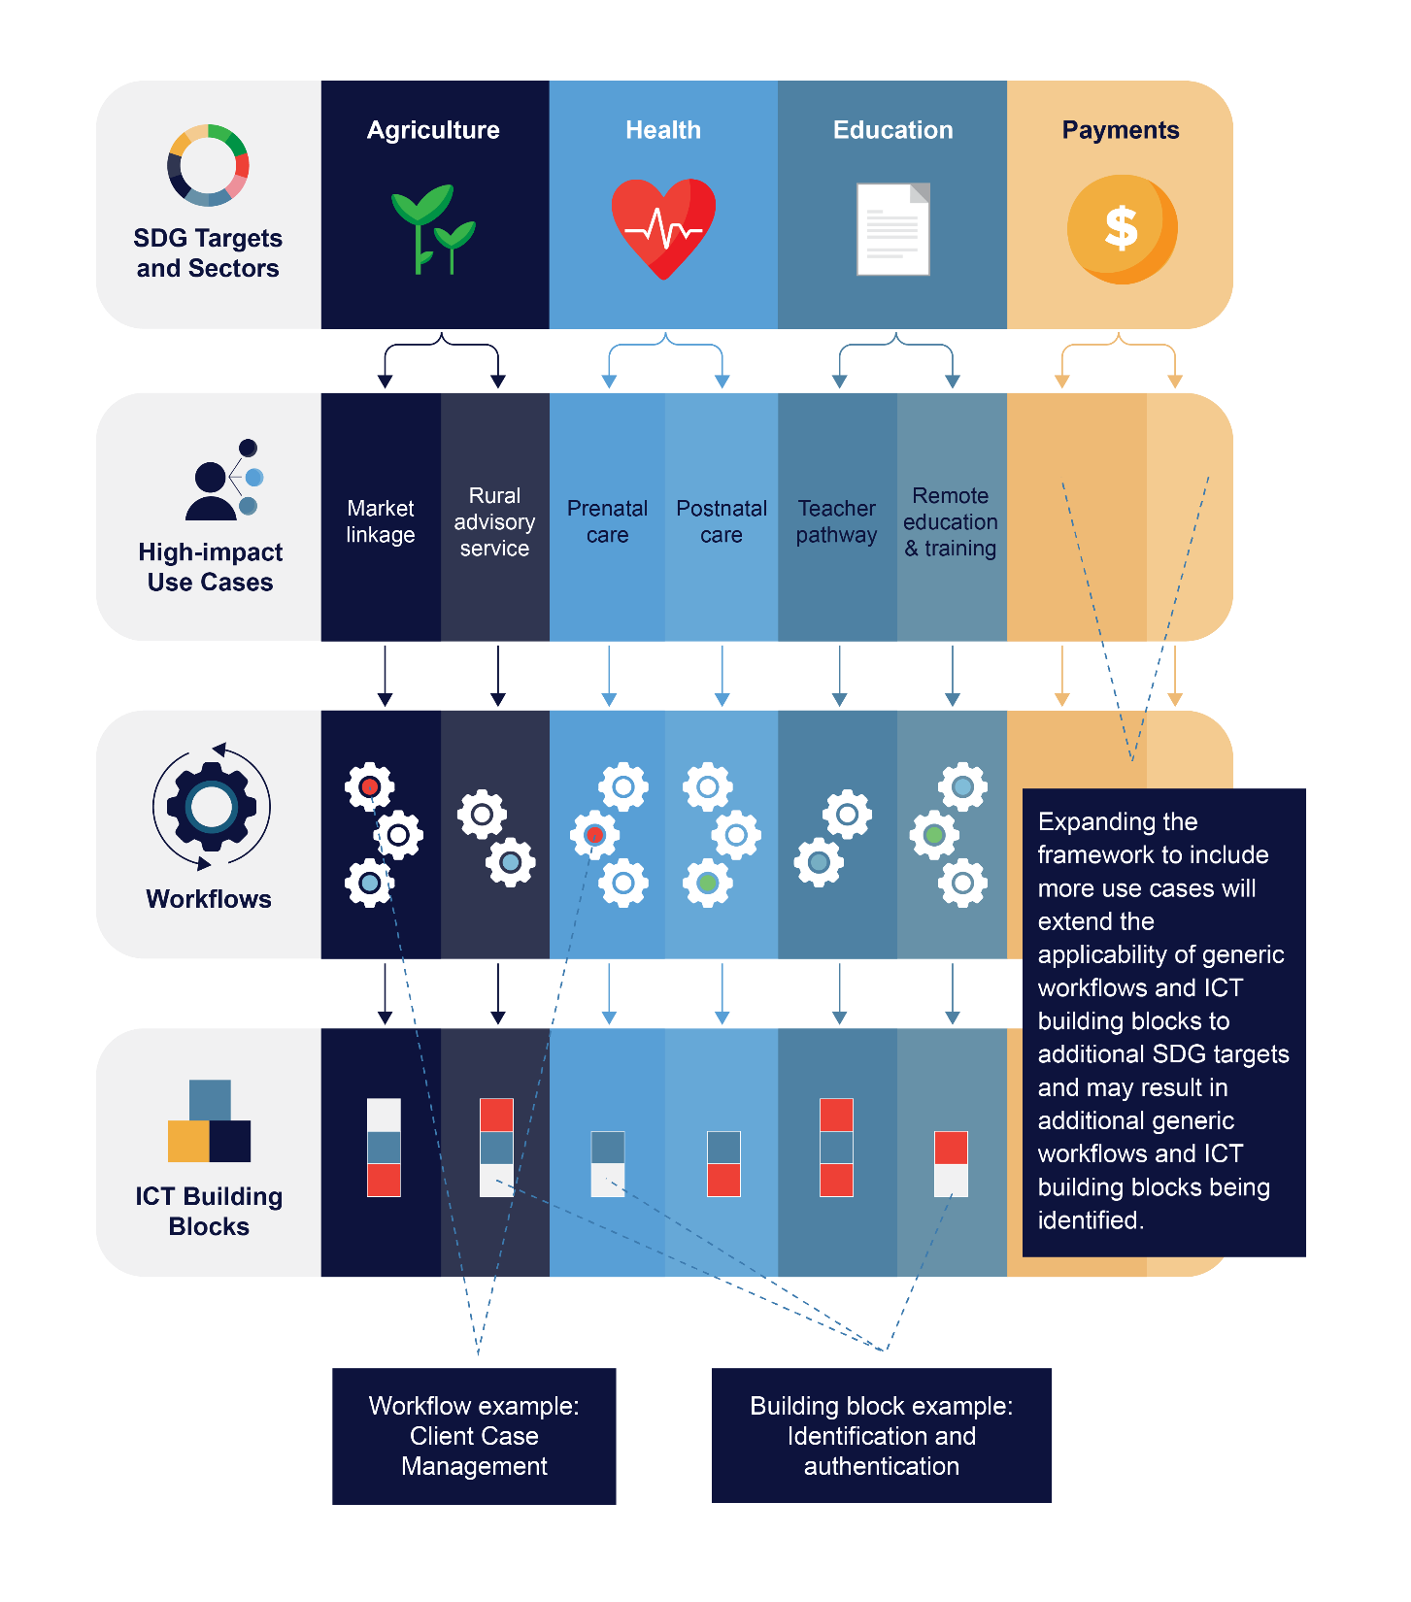
Through coordinated (re)use of these common digital components…
Ideal: Across sectors and government agencies, subset of same ICT building blocks can be put in place and leveraged. Whereas they are used to deliver one use case, such as agriculture market linkage service, their foundational design can be reapplied to deliver others additional use cases across multiple sectors.
Same components can be reused
Notes:
Left: full use case modeled and defined.

Slide 10
… these Building Blocks can be used to create one common platform to deliver various government services digitally.
A holistic (Whole-of-Government) digital platform that can be used by any government agency across sectors to build new e-gov. services without the need to redesign, test and operate the underlying systems and infrastructure themselves every time.
Adaptive shared citizen-centric e-gov. services facilitated by a service-oriented architecture
Mediation middleware
Open API Gateway, secure data exchange
Instead of creating unique and disparate solutions, use a common reusable stack of Building Blocks to form the core platform engine and contextualize various e-gov. services on top.
Common Applications Blocks
e-Learning, e-Marketplace, Business Intelligence / Analytics, Workflow, etc.
Foundational Blocks** Identity/Authentication, Security, Consent, Payment, Registration, Messaging, etc. ** Digital Public Infrastructure (DPIs) considered part of this foundational layer
Hosting

Slide 11
A holistic digital platform utilizing reusable stack of Building Blocks should help a country see a wide range of benefits...
Speed
Increases speed of delivery by facilitating reuse of core service elements and redirecting resources towards improving citizen outcomes.
Cost-efficiency
Provides common capabilities cross-departments / -agencies which avoids duplication of efforts, reduces cost to develop new e-gov. services.
Real economic return
Provides socioeconomic ROI by enabling faster and closer connections from government to addressing needs of citizens and businesses.
ONE government
Enables service delivery that links and invokes different parts of government, providing a connected, consistent and seamless user experience.
Agility + Responsiveness
Enable governments to design and deliver new services quickly to respond to needs and unexpected circumstances (e.g. global pandemic and disasters).
Integration + exchange
Enables integrated transactions and exchange of information across other equivalent stacks and systems through standards and open APIs.
Harmonized policies
Opens possibilities for aggregation of big data for richer insights that would help develop better nonconflicting policies and monitor operations.
Minimized vendor lock-in
Minimizes product ‘lock-in’ and allows independent services to run where modular Building Blocks could be replaced without impacting overall exp.
[Ref. on other documented rationalization w. AsiaPac. countries examples: GSMA Report "Advancing digital societies in Asia Pacific: a whole-of-government approach"]

Slide 12
…as evidenced by countries who have long adopted the approach and successfully accelerated their own transformation…
Estonia
Estonia among a group of countries w. "Very High" scoring of the UN's E-Government Development Index (EDGI) as of 2020 [2020 UN E-Government Survey]
99% of the public services are available online 24/7 with 44% Estonians voting electronically and an estimated 844 years of work saved. [e-estonia]
Estonia embraces a similar Building Block approach with an interoperability service called X-Road as the backbone of e-Estonia connecting 52,000 organizations as indirect users
Seamless cross-sector integration of gov. services can be viewed as demonstrations here.
Singapore
Singapore also among a group of countries w. "Very High" scoring of the UN's E-Government Development Index (EDGI) as of 2020 [2020 UN E-Government Survey]
SGN's "GovTech Stack" employs reusable microservices (similar to the approach of Estonia) e.g. national ID for authentication as one of the core layers in the stack.
Conscious reorganization of ministerial structure to allow for holistic cross-ministerial planning and approach with council of Ministry CIOs and whole-of-government coordination.
"To date, /based on 2019 KPIs on Digital Government Blueprint of Singapore/, 95% of /digital government service/ transactions (by volume) are completed digitally from end-to-end, meeting the target of 90-95%."
Australia
AUS' Digital Service Platform Strategy speaks of initiatives closely align to core principles of GovStack: API standards, "open architecture, interoperability standards and specifications", removing legislative and collaboration barriers, etc.
"Tell Us Once" principle (aligned w. overall concept of “Once Only” by common leading e-gov. examples)
Single MyGov portal with public KPIs to track gov. portal and service accessibility performance.

Slide 13
…with several others beginning to embrace tangible socioeconomic benefits by starting to adopt the approach.
India
In 2018, India published its government enterprise architecture, IndEA, which applied the whole-of-government approach to delivering common public sector services.
The IndEA framework guides investment into digital public goods, which in effect are centrally administered digital infrastructure and applications available to all sectors and facilitated by a set of Open APIs called “India Stack”.
A prime example is India’s national ID system (Aadhaar), with over 1.2billion subscribers.
Since its introduction, Aadhaar has stimulated the growth of India’s digital economy, enabling digital payments of US$ 57 billion, and saving the government US$ 13 billion in reduced transaction overheads.
[source: India: "SDG Digital Investment Framework," pg. 11 (DIAL and ITU, 2019)]
Benin
In 2020, the government of Benin launched a national e-services portal that serves as a single point of entry to all government public services – increasing accountability and accessibility.
While still nascent, the portal provides information about some 250 public services, and will ultimately be the place where most public services can be accessed digitally.
The platform is being built on top of the Estonian X-Road interoperability platform, with the goal of connecting different systems and databases across sectors, and creating a digitally integrated government. It will be supported in the coming years by digital ID, which will lay the foundation for national digital economy platforms and services.
[Benin: "Unlocking the Digital Economy in Africa," pg. 20 (DIAL, 2020)]
Notes:
We leave this today – many examples,

Slide 14
Estonia
e-estonia.com/solutions/
Notes:
>>> Marten

Slide 15
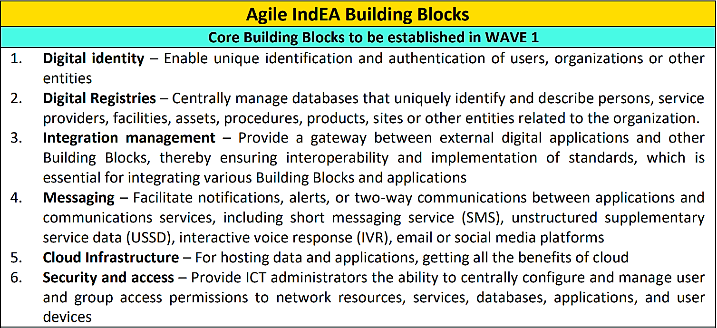
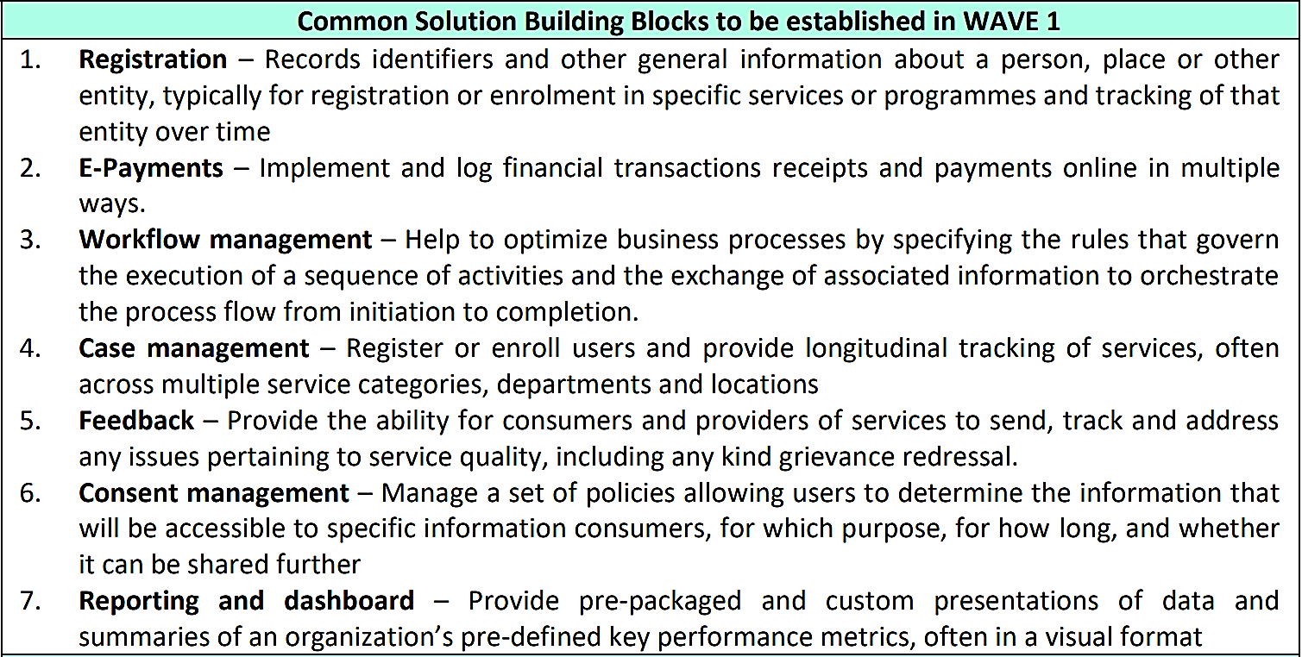
India
indiastack.org
With a broad ubiquitous inclusive platform that has no physical presence required, costs are reduced in designing new services with already significant social outcomes incl. rapid growth in bank account ownership, digital ID covering almost all population, and enhanced infrastructure reaching to more mobile devices. [source: digfingroup.com/what-is-india-stack]
Building Block classification from the Agile IndEA Framework (Version 1.0 | 2019) by India’s Ministry of Electronics & Information Technology [source: negd.gov.in/india-enterprise-architecture]

Slide 16
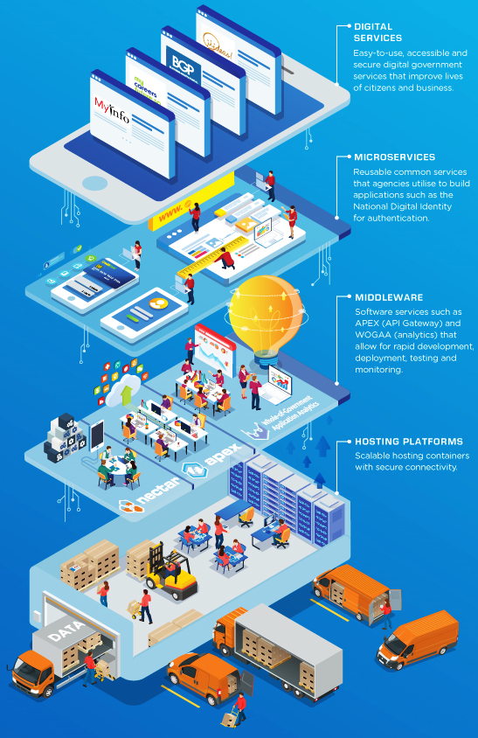
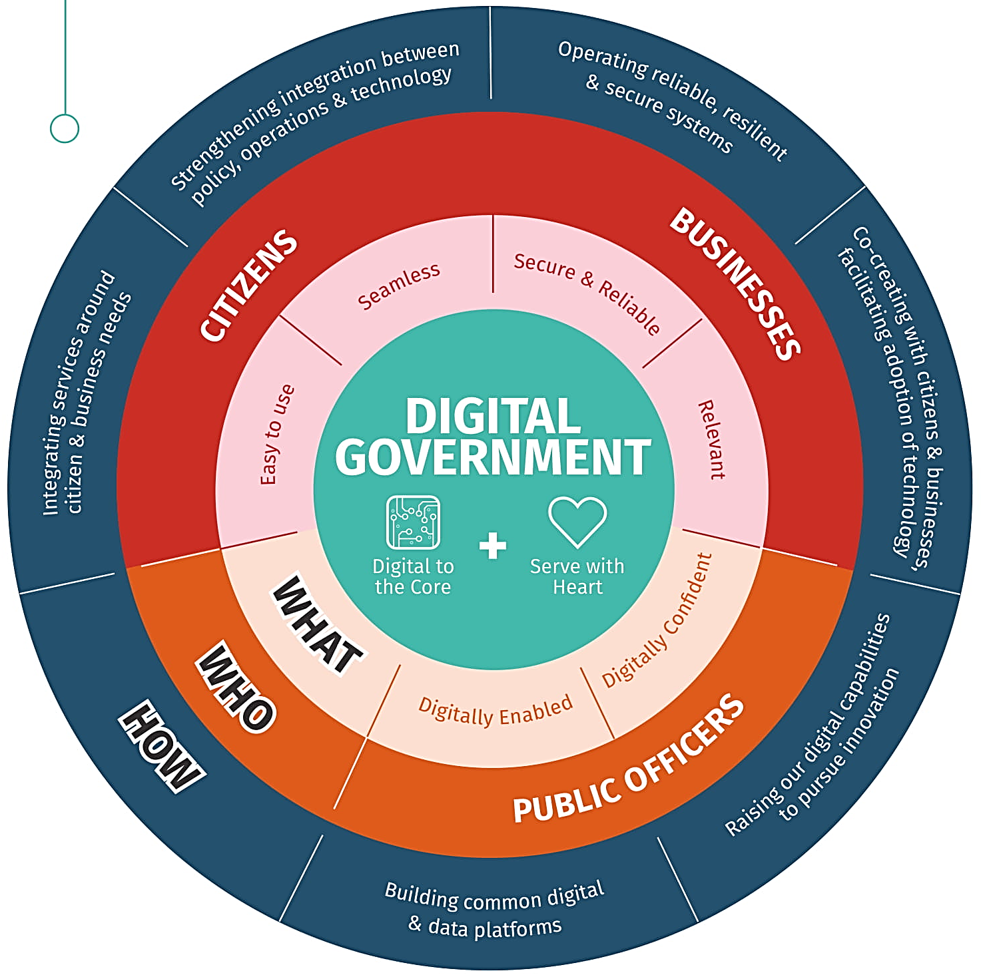
Singapore
www.tech.gov.sg
(LEFT) ”A Digital Government will be able to build stakeholder-centric services that cater to citizens’ and businesses’ needs. Transacting with a Digital Government will be easy, seamless and secure” with tangible setup and benefits incl.:
e-payment and e-signature options for 100% of Government services
Intuitive, accessible and easy-to-use digital services
Greater confidence in data as digital services infrastructure continues to be fortified
More digital services like Moments of Life and Business Grants Portal
[source: tech.gov.sg/digital-government-blueprint]
(RIGHT) “With SGTS, agencies would be able to tap on a suite of tools and services hosted on a common infrastructure to ensure consistency and high quality of their applications.” [source: tech.gov.sg/products-and-services/singapore-government-tech-stack]

Slide 17
Recent evaluations demonstrate the economic value of the building block approach
India
Australia
Saudi Arabia
“A report by India’s Ministry of Electronics and Information Technology suggested that a business-as-usual approach in India would create $500–650 billion in economic value from digital services by 2025. However, this is significantly less than the potential $1 trillion that could be generated in the scenario where digital technologies are fully utilized to unlock productivity, savings and efficiencies through a cross-sector collaborative approach across more diverse sectors…” [source: GSMA]
“… in June 2019, 284 websites and 91 agencies from all tiers of the Australian government were using the same content management system, GovCMS. A model by Deloitte was commissioned by the Digital Transformation Agency to determine WGA cost savings, which showed that the operating cost for the 284 sites would exceed $73 million if hosted independently. Since the total cost of operating GovCMS in 2018–2019 was $5.9 million, this amounted to an overall saving of $67.1 million.” [source: GSMA]
In initial analysis in effort to inform their drafted Sustainable Digital Investment Framework, implementing one Building Block (Remote Signature) in a holistic cross-gov. approach yielded a tangible total cost of ownership at 17mSAR, compared to 490mSAR if operated individually by 140+ gov. agencies along a 3-year horizon. “The investment optimization is consequent, 473mSAR for solely the Remote Signature as a Building Block.” [source: Cost optimization study by the Digital Gov. Authority of KSA]

Slide 18
Approach
3

Slide 19
GovStack is a joint initiative to bring this Building Block approach to a broader reality.
What is it?
GovStack is an expert community-driven multistakeholder effort aimed at deriving common technical practice and understanding of the Building Blocks approach as seen in implemented countries.
What does it aim to achieve?
By unpacking and simplifying the technical approach that goes into building holistic digital government, GovStack aims to accelerate countries’ ownership of e-gov. solutions and in doing so improve services for social well-being.
Where did it come from?
GovStack is an extension of the SDG Digital Investment Framework, an earlier effort by the Digital Impact Alliance (DIAL) at the UN Foundation and the International Telecommunication Union (ITU).
Notes:
IMPORTANT

Slide 20
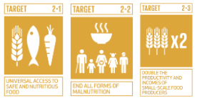
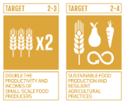
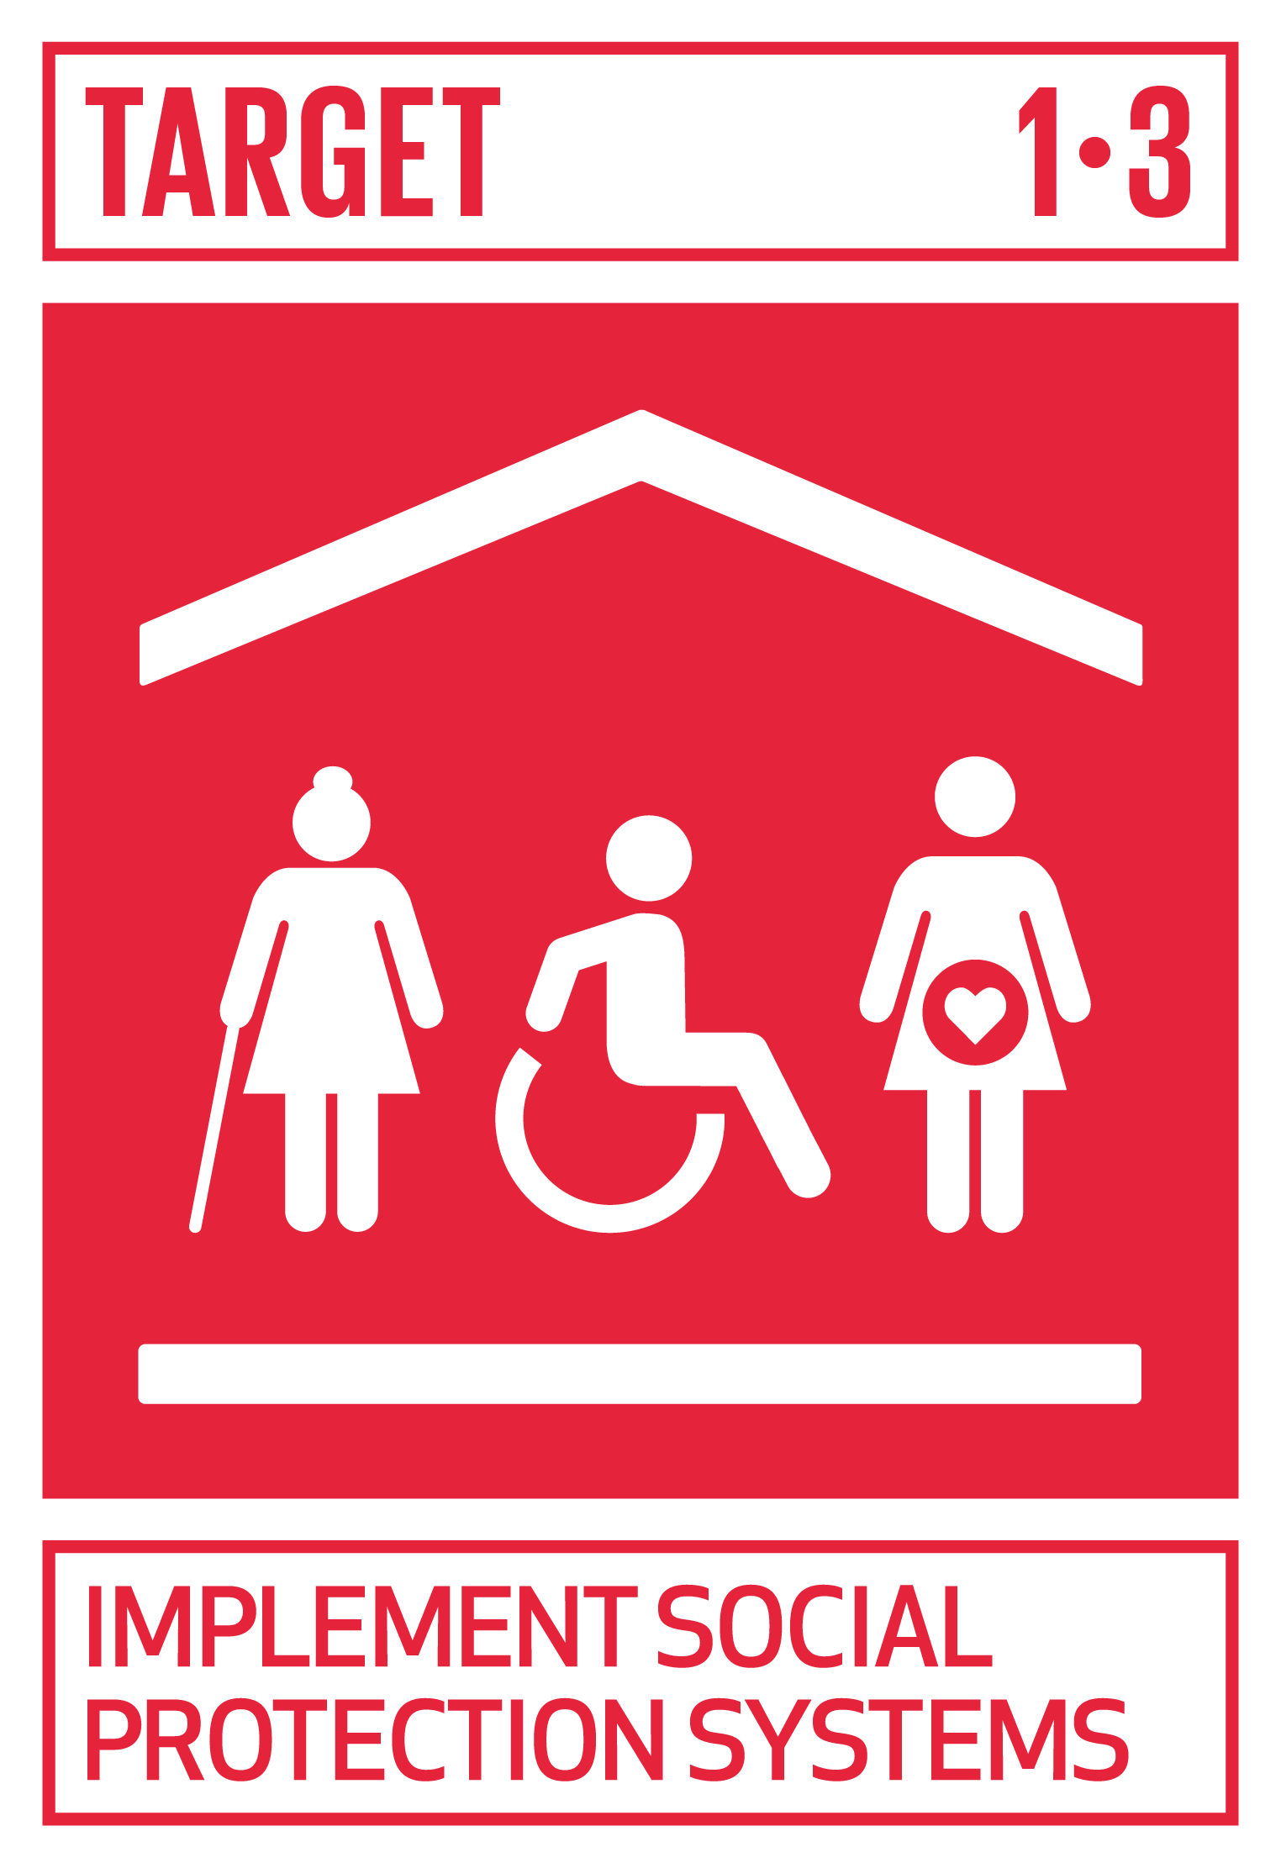
…with an eventual living platform showcasing interconnected solutions addressing multiple use cases, starting with these 5.
Use Case | SDG Targets | Brief Description
Postpartum and Infant Care (detailed here) |  | Profiles the care service for mother and child spanning the mother's prenatal and postnatal periods to ensure both are health. 7 steps.
Market Linkage (detailed here) |  | Profiles a service of information service delivery and provision of market linkage for rural farmers to improve incomes and their livelihoods. 9 steps.
Rural Agri. Advisory Services (detailed here) |  | Profiles a service connecting rural farmers to market information and other informational services with a vital role to improve knowledge. 9 steps.
Unconditional Social Cash Transfer** (detailed here) **a priority due to COVID |  | Profiles specifically the delivery journey of a generalized unconditional social cash transfer service provided to financially disadvantaged or vulnerable people or households without conditionality. 9 steps.
Remote Learning (detailed here) |  | Profiles a service for delivering digital content and tools that can be used to provide or supplement all types of learning in disconnected or connected environments. 5 steps.
Notes:
IMPORTANT

Slide 21
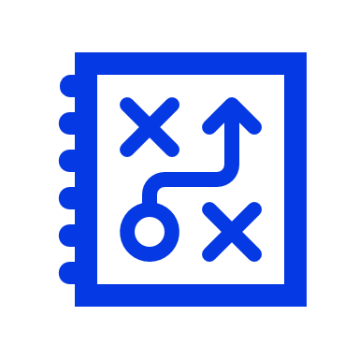
The next two years will focus on the following activities
 | Major Strategic Areas |  | Goal
1 Specify | Develop and evolve specifications for high-priority Building Blocks, and a Blueprint for an illustrative digital government service that uses them |  | Create technical reference pieces of generic digi. gov enabling components
2 Demonstrate | Invite product / approach demonstration and develop working reference models of the illustrative stack showcasing applicability of digital services, guided by specification outputs from Phase I (Building Blocks and Blueprint) |  | Show how the GovStack approach can employ a set of cross-sector, interoperable, secure and integratable Building Blocks to demonstrate delivery of a pipeline of digital services
3 Apply | Engage pilot countries to inform approach in their larger digital government strategy effort and implementation roadmap, and sustain ongoing advocacy and address country capacity needs |  | Ultimately inform national digi. gov strategy drawing from proposed approach + diff. reference models in their transformation journey

Slide 22
The next two years will focus the following roadmap…
Refer to details at Our Solution area of the GovStack website.
Specifications of various interconnected Building Blocks.
PHASE iii:
Platform
Phase ii: Procurement
Architecture blueprint
Business requirements and technical specifications for 10-12 Building Blocks
Accompanying open API conditions
OUTPUTS
Launch and execution of procurement tender to solicit service in delivering a first GovStack model
Starting w. survey market capabilities: see RFI call
OUTPUTS
OUTPUTS
Functional software environment demonstrating models / approaches to implementing GovStack by addressing multiple cross-sectoral use cases
Guidance and manuals for reuse
Repurposed resources from procurement effort into references to support similar exercise in partner countries
Phase i: Reference(s)
Living platform with reusable solutions illustrating reference implementations of the GovStack model that support multiple use cases, starting with the 5 listed.

Slide 23
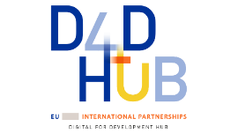
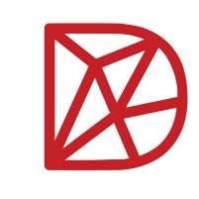
Interest and commitment to GovStack is already being demonstrated by national, regional and global partners…
Overall interest in consideration for member states (potential flagship)
Supporting regional approach to econ. integration under Single Digital Market pillar
Largely driven and supported by
Commitment from German Dev. Coop to support GovStack model in these countries
Part of the in-country “Digital Transformation Centers” by GIZ, and other GIZ country programmes
Informing DIAL support approach to digital strategy and related efforts in partner country (s)

Slide 24
... as part of an overall broad, comprehensive digital goverment effort (to inform technical approach)
Digital Governance
Policies / Regulations | E-Gov. Platform Infrastructure | Digital Services | Human Capacity | Innovation
Robust uplifted regulatory environment and policies to enable safe and effective use of services and ensuring data protection, LNOB, and human rights | Foundational digital platform setup (GovStack) to ensure services are cashless, paperless, presence-less, frictionless, personalized, consent-based, Once Only and citizen-centric | Priority and impactful digitalization of government services in Health, Agriculture, Education, Commerce, etc. | Smart workforce and visionary cabinet for Smart Government Change management and political will to support coordinated cross-agency effort Digital literacy to ensure population use and accessibility | Vibrant local innovation ecosystem and digital entrepreneurship to complement digital gov. service delivery
Connectivity and Access Quality, inclusive and affordable connectivity for all
Cybersecurity Strong protection to individual and commercial use of data and systems
Data Center and Hosting
Capacity Building II
Interoperability and Government Tech Stack (exchange of data, trust and security, digital identity, Payments, etc.)
Digital Government Enterprise Architecture
Cybersecurity

Slide 25
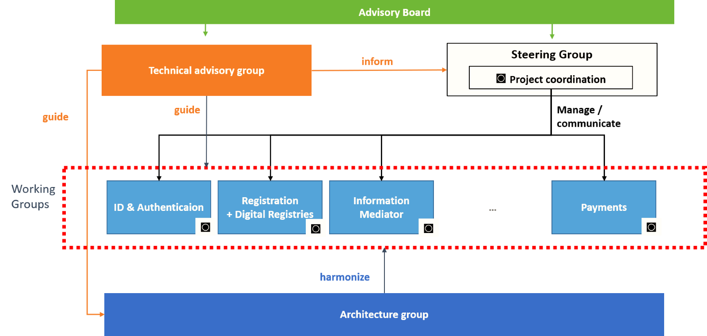
GovStack is driven by an interim governance and working structure…
1 Coordinating Body
Who: Comprised of founding members
What: Provide direction, institutional buy-in, resources, partnerships, agreements, and contracts
2 Technical Advisory Group (under development)
Who: Neutral experts providing overall technical guidance
What: Define and prioritize the Building Blocks, review use cases, standards, and output formats. Give final approval on specification publications and other reference outputs. Define future requirements and advise on ongoing changes in standards, relevant models and technical approaches
3 Architectural Working Group
Who: Diverse set of experts with knowledge of digital component interoperability design and methodologies
What: Develop architectural blueprint, and ensure interoperability / integration across Building Blocks
4 Building Block Working Groups
Who: Diverse set of subject matter experts; one group per Building Block
What: Develop each Build Block's unique specifications, and ensure interoperability with other Building Blocks
5 Advisory Council (under development)
Who: Small, representative group of strategic partners to help guide the GovStack initiative. Members will bring different perspectives to the group, drawing on their roles as donors, governments, private sector actors, users
5
1
2
4
3

Slide 26
…with the following Building Blocks technical working groups established
[1]
[2]
[3]
Wave 1
[1]Registration and Digital registries addressed as one
[2] Security potentially redressed as “Authentication”
[3] Identification & Authentication to focus on “Identification”
[1]
Wave 2
Notes:
Why – who is already engaged.

Slide 27
…guided by these core working principles…
Neutrality: We will give no priority preference or exclusivity to a specific product or standard. All outputs and working processes will be based on how well it helps us achieve our goal.
Generic: All knowledge products will be generic and comprehensive in capturing, as much as possible, all relevant design specifications, and will not be specific to any single products in-market.
Open-source: All final deliverables will all be open-source and publicly accessible for reuse and replication by anyone – they will be Digital Public Goods.
Standard-based: All knowledge products will capture and be guided by industry-recognized standards --or reuse those from another sector where a lack of standards exists.
Minimalistic: We will focus on the most common functionalities at the lowest maturity level that are required to deliver the minimum capabilities for each Building Block.
Agile: We will use quick cycles to develop documentation to test and validate, and then go for the next iteration.
Integration: We will ensure a seamless exchange of information across applications and delivered through different channels. Services should be “integrated by design."
Citizen-centric: Design will be centered around typical high-priority User Journeys and Use Cases related to the SDGs.
Together, these tenets broadly align with the

Slide 28
…with an eye towards longer-term adoption and sustainability of the model and assets.
Over time, GovStack plans to pilot, build on, and sustain the Building Block approach for the long-term
Accelerate
Pilot in targeted countries to learn from the approach
Evolve the approach and offer tools based on these learnings
Adapt and customize outputs for country contexts as appropriate
Connect
Develop more knowledge on Building Blocks (expand vertically)
Support more use cases (expand horizontally)
Support dev. of other reference models onto platform showing overall BB concept w. different implementation approaches
Sustain
Establish / solicit a neutral entity to own, maintain, expand on, and supply the assets developed
Establish community approach to maintain the working groups to continuously inform / evolve Building Block design over time
Potentially certify Building Block solutions and refs. (via DPGA CoP, via ITU standardization)

Slide 29
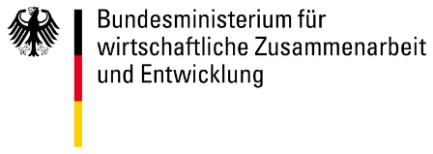
GovStack also has these anticipated impacts to different strategic areas of the ecosystem, as represented by each of its founding partners.
Donor harmonization
Country Capacity
Future eGov vision
Ecosystem Alignment
Stakeholder area rep. and impact desired by:
Donor alignment: Model designed to incent donors to coordinate investments and address each part of problem in digitalization jointly. It also works to align actors along common DPG/DPI policies and offers a common approach for donors to finance efforts.
Digital investment optimization: Focus on generic sets of product requirements by building block to maximize donor ROI by breaking down siloed project-based single-use digital investments
DX catalyst: By demystifying leading examples, digitization of service delivery and access can be accelerated in low-resource setting towards fulfilment of SDGs
Increased capacity: In-country capabilities can be strengthened through knowledge/skills transfer, and learning from reference implementation. Learning by doing.
Country ownership: Generic model gives governments ability to refine their own blueprints while relying on scalable building blocks
Fully citizen-centered services: With faster setup with reusable components, governments can proactively put citizen engagement and inclusive growth front-and-center to facilitate creation of a frictionless, paperless platform
Resiliency: Sets a foundation for future e-governance that ensures flexibility and resilience
Informed policymaking: Model can enhance data-driven decision-making given cross-sectoral linkage and smarter governance
Guiding blueprint: Model provides well-developed technical approaches to realize Whole-of-Society digital transformation efforts. This can then be used by any country, anywhere
Industry alignment: Generic reference(s) encourages public and private sector to build strong, mutually beneficial partnerships to increase supply of fewer, proven digital goods and responsible data use. Engages private sector in discussions on requirements, capacity development and financing
Notes:
IMPORTANT
Coordinated financing – digital investment

Slide 30
Ultimately, GovStack aims to resolve many of the key challenges hindering digital transformation
Lack of updated and comprehensive national ICT plans with KPIs and timetables
Limited financing and procurement for ICT projects
1
5
2
Limited coordination of ICT strategy implementation across government
Lack of interoperability frameworks in systems leading to siloed approaches
6
3
Ineffective governance and institutional frameworks to steer digital transformation efforts
Technical effort that facilitates functional / structural change to resolve other areas
Human capacity, digital literacy, and limited competencies amongst the workforce
7
4
Limited access to infrastructure across the country, affordability and internet access
Limited cross-border integration of systems and regulatory frameworks
8

Slide 31
Partnership
4

Slide 32
The founding partners
ITU, Estonia, GIZ, and the Digital Impact Alliance began a collaboration in 2020 with the goal of accelerating national digital transformation and the digitalization of government services for achievement of Sustainable Development Goals by 2030.

Slide 33
Four founding partners – each representing a different part of the digital ecosystem – are currently overseeing operations.
Founding Partner | Primary Role
 | Technical leadership: overall management of the technical components, including engagement with / advisory to experts, and guiding technical working direction
 | Advocacy and events: overall PR and awareness-raising in a range of forums, including strategic advocacy, events, and other convenings
 | Partnership and engagement: assessing and engaging partners at the institutional levels for resource and expert support, and navigating the effort towards longer-term sustainability
 | Strategy and coordination: Advising on overall strategy, managing the tracking of activities and issues; reconciling and harmonizing dependencies and protocols
Notes:
Here is where we need your help

Slide 34
There are many ways for interested organizations, individual experts, and country governments to join the effort Learn more at https://www.govstack.global/
Example engagement options | Description
Participate in our community | Join the conversation or email us at info@govstack.global
Strategize: Invitation only Advisory Board * *part of planning for longer-term governance | Sets the global vision and supports stakeholder coordination to invest and shape Digital Government agenda. Composition includes selected seats for: Donors, Countries, Tech Groups, Private Sector, CSOs.
Build: Share pipeline of use cases and be part of Building Block specification effort | Representing sector-specific digital solutions / topics to explore using the GovStack model to demonstrate applicability of platform approach in their use cases, e.g. health, social protection, education, etc. Provide expertise and be a part of the discussion and technical effort to inform the current Building Blocks specification design of the Phase 1
Share: GovStack Stakeholders Platform | Share, learn, advocate, network: open continuous forum for discussion! See following.
Advise technically: Technical Advisory Grp. (under development: open for nominations) | Be a part of a technical advisory body of the GovStack governance structure to provide unbiased objective input to the technical decision points, and review / validate specification and other reference outputs
Invest with us: Develop concepts and investments | Invest in the development of the model government platform and the regional and local adaptation in a GovStack partner country or beyond. If you have a proposal or concept development for programme or country e-gov. strategy requiring the framing / understanding of WGA/BB/govstack model, GovStack founding partners can support / provide input.
Notes:
CALL TO ACTION
And here is some specific ways to engage -

Slide 35
The initiative would also benefit from engagement from country governments that align to its vision / concept.
What Governments can also do | What it means
Support a technical working group via active role | Help the effort of individual technical working groups by contributing experts (from the ICT ministry and others) to formulate common requirements for specific Building Blocks and incorporate on-the-ground / country context
Publicly express interest in being a champion country (under-concept) | Sign a declaration of interest or issue statement indicating willingness to demonstrate best practices, support capacity building, and advocate for value of shared digital infrastructure / DPIs, or to showcase adoption of the approach – e.g. employing Building Blocks in line with GovStack’s specifications, and technical and financing to realize e-gov platform in-country

Slide 36
A GovStack Stakeholders Platform will facilitate open participation from groups around the globe.
Aiming to be a quarterly / biannual convening to allow:
Expert working groups and community meetup in-person and build rapport, exchange knowledge and discuss next steps in the technical direction of the initiative
The formation and meeting of the Advisory Council (invitation-only side function) consisted of a balanced spread of stakeholder groups to set the future strategic view and discuss / explore partnerships, review governance elements
High-level panel discussions describing latest trend in e-gov. in relation to GovStack approach and inspiration from the model
Open auditorium (parallel track) with open invitation to general participation by country delegates, technical knowledge grps, industry associations, other relevant stakeholders to share experiences and connect ideas.
Ongoingly: open engagement also available via online forum (under development)
First installment being planned at the 2021 Digital Tallinn Summit.

Slide 37
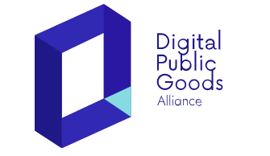
In addition, broader ecosystem alignment is underway to align across stakeholders
What Partners can do | What it means | Examples
Provide strategic in-country implementation and support | Given increasing country interest, aligning other partners with complementary TA / knowledge / service e.g., training, strategy development, eGov. Assessment. Long-term: Advocate to partner governments about the GovStack model, help identify more pilots, and work with governments to include GovStack in their digital transformation strategies​.
Evolve Building Block specification effort | Support ongoing effort of individual working groups for specific Building Blocks, acting as an honest broker and ensuring balance across the group, sustain the specific practice areas
Help create the long-term institution | Help design and support the establishment of a dedicated body to maintain and scale up the model government platform as a Digital Public Good. | —
Help ensure country- and civic- “centricity” | Facilitate the inclusion of government input, review and other authorities to bolster open and user-centered design processes.
Help strengthen the ecosystem | Support target countries in setting up the right operational processes and strategies to put the GovStack model into practice, and inform ongoing recommendations / recognition of viable solutions | (in discussion)
Notes:
ITU Estonia
Hani + Marten
Two ways to invest – model platform / country implementation

Slide 38
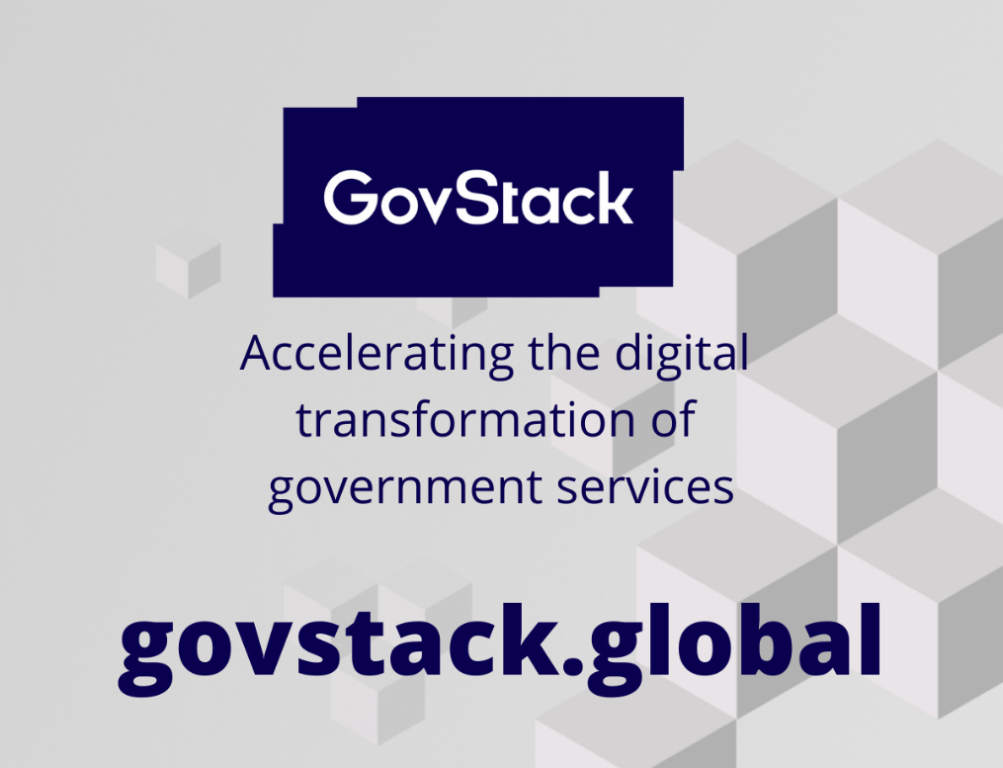
To get in touch:
info@govstack.global
Standard FAQs (forthcoming)

